Slide 1
Continuing Legal Education
Colorado Department of State

Slide 2
Colorado Title Setting board citizen initiative process
Theresa M. Conley
Colorado Department of State
July 2024

Slide 3
Overview of Presentation
What is the Title Board
Brief overview of citizen initiative process
Deeper Dive into Title Board requirements
Summary

Slide 4





Overview of Citizen Initiative Process
Idea for new law
Review & Comment process
Title Setting Board
Appeal to Colorado Supreme Court
Collect signatures

Slide 5
Review & Comment Process
Submit measure to Colorado Legislative Council staff
Review and comment process
Memoranda – provided at least 48 hours before meeting, outlines technical and substantive comments.
Meeting – set 2 weeks after submission, walk through memo
Purpose
Review wording with proponents to ensure the initiative accomplishes proponents' intent
Provide public notice that a proposal on the topic is under consideration

Slide 6
Review & Comment Memo and Meeting
Review & Comment Memo
Purposes
Substantive Comments and Questions
Technical Comments
Do not opine on merits of the measure, provide legal counsel, or specifics on how to change
Review & Comment Meeting
Designated representatives must attend.
Held in Capital or legislative services building
Walk through Review and Comment Memo
Public Meeting, audio recorded, no comments
Made edits in response to memo and hearing

Slide 7
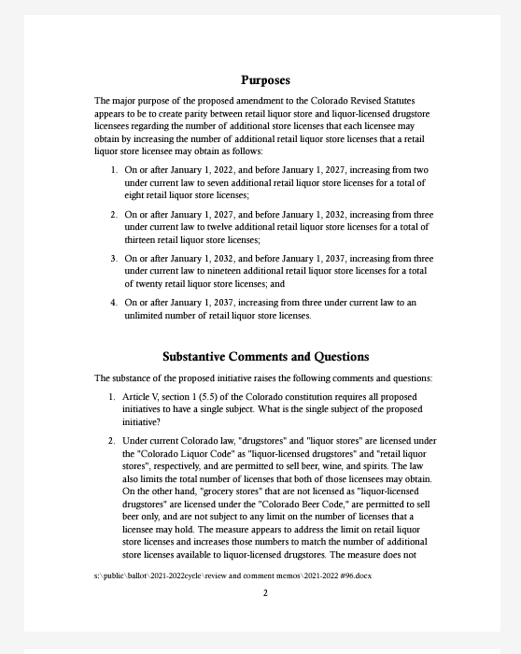
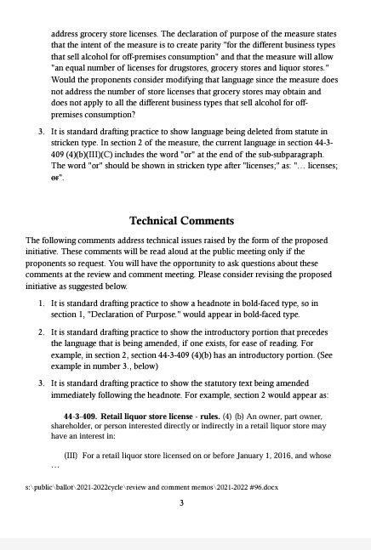
Memo Example

Slide 8
Overview of Citizen Initiative Process
Idea for new law
Review & Comment process
Title Setting Board
Appeal to Colorado Supreme Court
Collect signatures

Slide 9
Title Board Overview
Sets titles for citizen-initiated ballot measures. Question on the ballot.
“Shall state taxes be increased by….”
Sessions run about 18 months
Even year November through next even year April (18 months)
Held 1st and 3rd Wednesdays
Secretary of State’s Office
Public meetings, public comment allowed, audio recorded

Slide 10

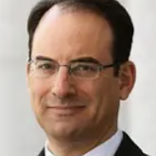


Who is on Title Board?
Designee of
Jena Griswold
Colorado Secretary of State
Designee of
Phil Weiser
Attorney General of Colorado
Designee of
Ed DeCecco Director of OLLS
Clerk for the Title Board

Slide 11
Title Setting Process
Initial Hearing
Proper Submission
Single Subject
Set a title
Rehearing
Single subject
Clear Title
Fiscal summary
Appeal to the Colorado Supreme Court

Slide 12
Collecting Signatures
Petition format approved by the CO Secretary of State’s Office
Circulate throughout state to collect signatures
Only registered electors
5% of all votes cast for CO Secretary of State Office = 124,238

Slide 13
If successful in all these steps, the measure should be on the ballot.

Slide 14
Overview of Citizen Initiative Process
Idea for new law
Review & Comment process
Title Setting Board
Appeal to Colorado Supreme Court
Collect signatures

Slide 15
Duties of the Title Board?
Determine single subject
Designate and fix title
Consider public confusion cause by misleading or unclear title for which YES or NO vote would be unclear
Intent, effect on current law, change in status quo
Debate or create policy ideas
Analysis and deep dive into why the proponents are advancing a measure.
Do not edit or work on the substance of the initiative.

Slide 16
Legal Authority
Colorado Constitution
Title 1, Article 40 of the Colorado Revised Statutes
Open meetings law
Title Board Policies and Procedures

Slide 17
Steps in the Title Setting Process
Initial Hearing
Proper Submission
Single Subject
Set a title
Rehearing
Single subject
Clear Title
Fiscal summary
Appeal to the Colorado Supreme Court

Slide 18
Initial Hearing
Policy: Provide public notice that a proposal on the topic is under consideration
Filing or procedural discrepancies
Filed all proper materials
Designated representatives present
Single subject determination
Constitutional and statutory requirement
Set title
Use OLLS draft

Slide 19
Submission to Title Board
What
Initial Draft
Amended – tracked changes made after Review & Comment hearing
Final draft
When
Strict filing requirements – Friday by 3 pm, 12 days before title board
Who
Designated representatives must attend all hearings
Public may attend and make comments

Slide 20
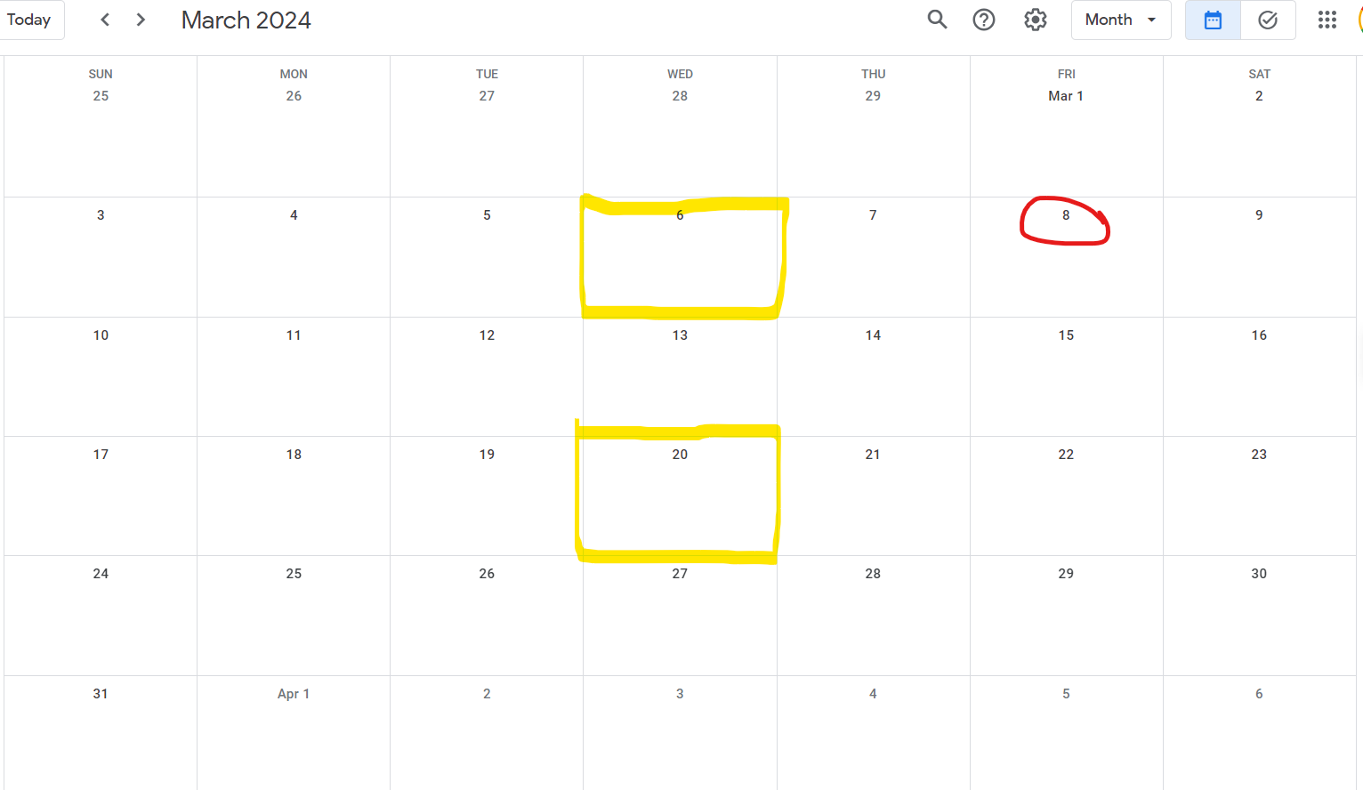
Submission calendar

Slide 21
Filing or procedural discrepancies
Policy: Provide public notice that a proposal on the topic is under consideration
All documents filed*
Designated representatives are both in attendance
Substantial changes made after Review and Comment*
Made in response to review and comment memo or meeting, permissible
Substantial changes made that are not in direct response to R&C comments, must resubmit to Leg Council
* Common errors

Slide 22
Single Subject
Jurisdictional issue
Colo. Const. Art. V, Section 1(5.5) and 1-40-106.5,C.R.S.
Purposes
Prevent fraud and voter surprise
Ensure measure can pass on its down, prohibit incongruous subjects
Look for
Log rolling
Coiled in the folds
What is the voter voting yes or no on?

Slide 23
Single Subject examples
Alcohol sales & delivery
Recall process – expanded to include non-elected officials
Tax cuts and mandatory state spending
Growth management
So unclear cannot set title

Slide 24
Clear Title
Short, clear, concise title. 1-40-106, C.R.S.
“The title should enable the electorate, whether familiar or unfamiliar with the subject matter of a particular proposal, to intelligently determine whether to support or oppose such a proposal.
Titles for which the general understanding of the effect of a “yes/for” or “no/against” vote will be clear.
Requirements under the Constitution and statute
Taxpayer’s Bill of Rights (TABOR) Colo. Const. Art. X, Section 20
State statute

Slide 25
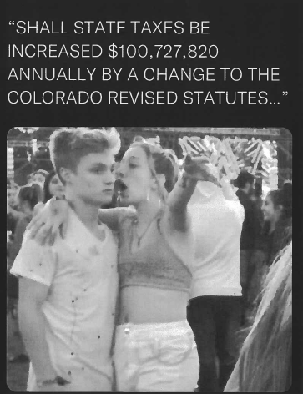
Girl explaining meme

Slide 26
Specific Title Language Required by Law
Increase of taxes
Ballot titles for tax or bonded debt increases, TABOR - Colo. Const. Art. X, Section 20,
“SHALL STATE TAXES BE INCREASED $1,500,000 ANNUALLY…”
Tax change
Reduction of state tax revenue or local district property tax, 1-40-106(3)
Shall funding available for counties, school districts, water districts, and other districts funded, at least in part, by property taxes shall be impacted by a reduction of $3 billion in property tax revenue by a change to the Colorado Revised Statutes concerning a reduction of the valuation for assessment of certain real property for property tax years commencing on or after January 1, 2025, and, in connection therewith, reducing the valuation for tax assessment for property other than residential real property, producing mines, and oil and gas lands to 24% of the property's actual value; reducing the valuation for tax assessment for residential real property to 5.7% of the property's actual value; requiring the state to reimburse local districts for revenue lost as a result of these changes; and requiring the state to maintain current funding for the state education fund?

Slide 27
Clear Title Guidelines
Aim is to capture, succinctly and accurately and initiatives plan meaning
Prevent voter confusion
Voter understand what a YES or NO vote would mean
Considerable discretion
Intent, effect on current law, change in status quo
Board has discretion
Set out every detail in measure
Use only language or terms in measure
Merit of the measure
Constitutionality
How conflict of interact with current law
Catchphrase

Slide 28
Clear Title - Example 1
Shall there be a change to the Colorado Revised Statutes concerning increasing the number of retail liquor store licenses in which a person may hold an interest, and, in connection therewith, phasing in the increase by allowing up to 8 licenses by December 31, 2026, up to 13 licenses by December 31, 2031, up to 20 licenses by December 31, 2036, and an unlimited number of licenses on or after January 1, 2037?

Slide 29
Clear Title – Example 1 highlighted
Shall there be a change to the Colorado Revised Statutes concerning increasing the number of retail liquor store licenses in which a person may hold an interest, and, in connection therewith, phasing in the increase by allowing up to 8 licenses by December 31, 2026, up to 13 licenses by December 31, 2031, up to 20 licenses by December 31, 2036, and an unlimited number of licenses on or after January 1, 2037?
Single subject
Connection
Description

Slide 30
Clear Title – Example 2
Shall there be an amendment to the Colorado Constitution and a change to the Colorado Revised Statutes concerning money that the state receives, and, in connection therewith, requiring all money received by the state, including money provided to the state for a particular purpose, known as custodial money, to be subject to appropriation by the general assembly after a public hearing; repealing the authority to disburse money from the state treasury by any other means; requiring all custodial money to be deposited into the newly created custodial funds transparency fund and the earnings on those deposits to be transferred to the general fund; and allowing the state to retain and spend all custodial money and earnings and revenue on that custodial money as a voter-approved revenue change?
Single subject
Connection
Description

Slide 31
Clear Title – Example 2 highlighted
Shall there be an amendment to the Colorado Constitution and a change to the Colorado Revised Statutes concerning money that the state receives, and, in connection therewith, requiring all money received by the state, including money provided to the state for a particular purpose, known as custodial money, to be subject to appropriation by the general assembly after a public hearing; repealing the authority to disburse money from the state treasury by any other means; requiring all custodial money to be deposited into the newly created custodial funds transparency fund and the earnings on those deposits to be transferred to the general fund; and allowing the state to retain and spend all custodial money and earnings and revenue on that custodial money as a voter-approved revenue change?

Slide 32
Clear Title – Example 2 with bullets
Shall there be an amendment to the Colorado Constitution and a change to the Colorado Revised Statutes concerning money that the state receives, and, in connection therewith,
requiring all money received by the state, including money provided to the state for a particular purpose, known as custodial money,
to be subject to appropriation by the general assembly after a public hearing;
repealing the authority to disburse money from the state treasury by any other means;
requiring all custodial money to be deposited into the newly created custodial funds transparency fund and the earnings on those deposits to be transferred to the general fund; and
allowing the state to retain and spend all custodial money and earnings and revenue on that custodial money as a voter-approved revenue change?

Slide 33
Rehearing
Grounds
Single subject determination
Clear title
Fiscal Summary – provided by OLLS a few days before the hearing
Motions can be simple
Clearly state grounds or language at issue
Board often will reverse decision
Fiscal summary
Misleading or prejudicial
Does not comply with statute in 1-40-105.5, C.R.S.

Slide 34
Appeal to Colorado Supreme Court
Who can file
Designated representatives
Registered elector who filed a motion for rehearing
Timing
Deference to Title Board
great deference to the title board;
drawing all legitimate presumptions in favor of the title board’s decision; and
only overturning the board’s decision in a clear case.

Slide 35
What ballot?
ODD YEAR ELECTION
TABOR QUESTIONS
New tax
A tax rate increase
Extension of expiring tax
Change to revenue net gain
Emergency taxes
Multi-year debt collection
Increase in property assessment rates
EVEN YEAR
No limitations
Higher turn out elections – Presidential, Congressional offices, state offices

Slide 36
TIMELINES
November 2024 - April 2026
TB hearing – 1st and 3rd Wednesday
Submit 12 days before hearing
Rehearings – motions due 7 days after hearing
April hearings – get on November ballot
6 months to collect signatures, but no later than 3 months before election
Odd year elections restricted

Slide 37
2024 Outlook
2 Measures on the ballot
1 Measure under signature review
14 Approved for circulation
August 5, 2024 Deadline to submit signatures

Slide 38
Summary of Best Practices
Start early
Watch the calendar
Be organized – track your changes, edits, and versions closely
Don’t skim on appeal grounds
Make some decisions

Slide 39
QUESTIONS?

Slide 40
Additional Courses
Legal Considerations for Cybersecurity and Privacy - August 13, 2024
Legal Considerations for Cybersecurity and Privacy is a one-hour course that explores the legal implications of cybersecurity incidents, including data breaches and ransomware attacks. Relevant laws and regulations governing cybersecurity, the importance of cybersecurity for businesses, pros and cons of cyber insurance, and compliance with terms of use, cookies, privacy tracking, and accessibility requirements. Additionally, the course covers developing and implementing a cybersecurity program, protecting client and customer data, and staying informed about the latest threats and best practices.
Top 10 Violations of the Revised Uniform Law on Notarial Acts - September 12, 2024
Top 10 Violations of the Revised Uniform Law on Notarial Acts (RULONA) is a one-hour course. Attorneys will be presented with issues surrounding coercion and fraud, specifically as they relate to elder abuse and vulnerable clients. Finally, attorneys will receive resources to help them, or their staff, remain compliant with RULONA and to protect their clients.
Public Data Fundamentals for Lawyers - October 8, 2024
Public Data Fundamentals for Lawyers is a one-hour course that will provide helpful information on the basic concept of public data, the current environment and availability of public data resources, useful examples of public data in action, and the considerations and precautions to take when using public data. As the availability, reliability, and utility of public data grows there is a recognized need to increase awareness and provide the public with resources to leverage the benefits of publicly available data. Whether an attorney works in the public sector or in private practice, this course is intended to make customers aware of the public data resources available at their fingertips.

