Slide 1
Continuing Legal Education
Colorado Department of State

Slide 2
Public Data Fundamentals for Lawyers
Notes:
Thanks for being here…

Slide 3
Colin Whetsel OST Manager | Department of State 303.894.2200 x6261 colin.whetsel@coloradosos.gov
Notes:
Thanks for joining to online and in-person audience
Name, Title, data analysis experience
Providing this presentation on behalf of the Business Intelligence Center
Real quick before we get started, a disclaimer…

Slide 4
Disclaimer
Disclaimer
I am not a lawyer
Notes:
It probably comes as no surprise to all of you to learn that I am not a lawyer.

Slide 5
Agenda
Agenda
Introduction
Background
Foundations of Public Data
Current State of Public Data
Helpful Tips & Resources
Q&A

Slide 6
Background
Notes:
1. Open public data has plenty of advocates out there
a. Merits stand on their own
2. And for those that are wondering why SOS’s office has an interest…

Slide 7
Business Intelligence Center (BIC)
Business Intelligence Center (BIC)
Created by HB16-1014
Adds C.R.S. § 24-21-116
Program within the Business & Licensing Division
The purpose of the program is to streamline access to public data and to provide resources to make the data more useful.
Notes:
Signed on 6/10/2016
The programs operations may include
(a) Assist state agencies in formatting and publishing data to a publicly available platform in a machine-readable format;
(b) Provide resources to facilitate the more effective use of public data;
(c) Solicit feedback from the business community to identify the types of public data and research tools that would be helpful;
(e) Assist local governments in publishing public data.
The SOS B&L rationale was an existing expertise with digital business registry and other public data

Slide 8
Business Intelligence Center Cont.
Business Intelligence Center Cont.
C.R.S. § 24-21-116 defines public data as data collected by a state agency or local government that is not required by law to be confidential
Notes:
1. I do think it might be helpful to pause and recognize variations in defining public data and open data.
a. From my understanding in more general terms public data differs from how I’ll be using today.
b. Generally, open data is probably the term that’s closer to mark
i. Open data and content can be freely used, modified, and shared
2. For the sake of this presentation, the definition in BIC statute will serve our purposes going forward.
3. Depending on the context, public data can mean different things

Slide 9
Fundamentals of Public Data
Notes:
When discussing the underlying principle behind public data I usually like to start with a question…

Slide 10
Does data have value?
Yes
Notes:
…please put your hands down, no need to unmute your mics, this is a rhetorical question.

Slide 11
Does data have value? Cont.
Does data have value?
C.R.S. § 24-21-116 (1)(a) The General Assembly hereby finds and declares that:
(I) Public data is a valuable resource that can assist businesses with strategic planning and decision-making.
Notes:
Included in 24-24-116 the General Assembly.
Now this is 2016…
…for reference Facebook’s IPO was in 2012 with a valuation of $103B,
The point is, turn of 21st Century tech companies emerge…
…no pricing model for their product, no subscription fees, no licensing fees…
…generating revenue/profit from selling their end users data…
Who it’s worth noting are accepting user agreements & terms that voluntarily turn over their data
As we know now, Meta is valued at $1.5T, seems that every company has an app that in ways large and small capture end user data.
Data is a tech company’s competitive edge, their trade secrets
The most current example is AI, Google, OpenAI, you name it these AI models are based on the webs data.
New York Times article from April of this year reported, that these companies are now using AI to generate content/data to feed into other AI learning models because they have run out of data on the web.

Slide 12
Philosophy & Data
Philosophy & Data
Data is valuable
Governmental agencies are in possession of large amounts of data
Governmental agencies are funded by the public
“Of the people, by the people, for the people”
Notes:
Consider the confluence of public data and philosophy
So we’ve established…
Data is valuable, especially in larger datasets
Govs have the authority and generate and store lots of data through the normal course of business…
…AND…
3. Gov agencies are funded by taxes, filing fees, licensing fees, reporting fee, permitting fees. They all lead to the same place, their funded by the public
4. I think it’s fair to conclude that the data produced and retained by gov agencies should be public.
This is the people’s data.

Slide 13
Reminder…
Reminder…
C.R.S. § 24-21-116 defines public data as data collected by a state agency or local government that is not required by law to be confidential
Notes:
As with most idealistic, high-minded perspectives, there is a conflict that arises with reality.
It’s fair to expect limitations, pretty inarguable, that some data should not be made public

Slide 14
Considerations
Considerations
Recognition of good data stewardship practices
HB21-1236 added the publishing of an interdepartmental data framework and protocol (C.R.S. § 24-37.5-703)
Obligation and responsibility to protect PII
Data relationships and possible triangulation
Notes:
Business processes data capture as required by law, but not all of that should be unceremoniously dumped online
Efforts have been made in Colorado formalize PII protection
Confidential data and PII protections, to say nothing of legal liability of falling short
Extends to being thoughtful about how relationships between datasets could be used to uncover or produce PII
Striking a balance between allowing public access and protecting individuals’ privacy – Notary example

Slide 15
Current State of Public Data
Notes:
That’s the summary of the principle behind public data. So, what’s does public data look like on the ground.

Slide 16
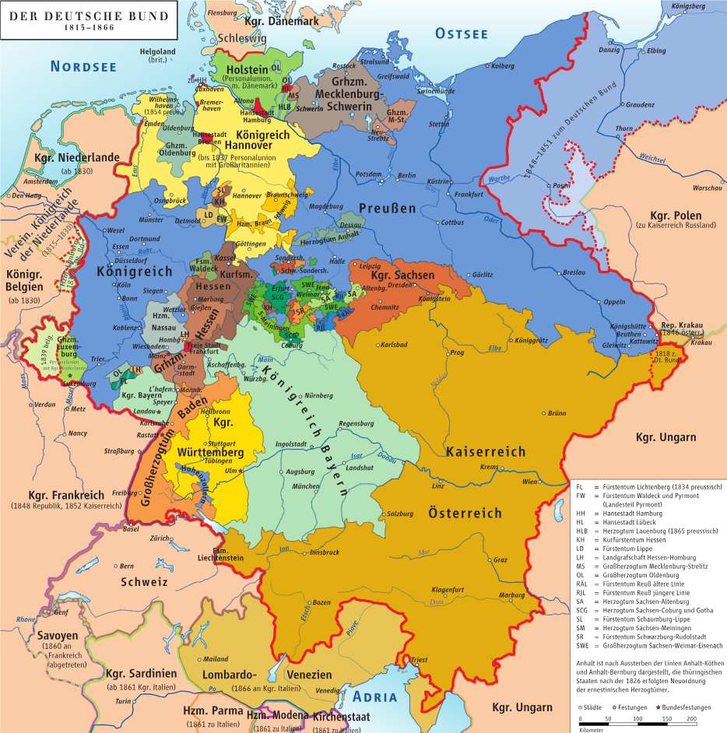
Decentralized Public Data
Decentralized Public Data
Making public data available is a large effort.
Each agency has largely pursued making data available independently
Factors that contribute:
System interoperability limitations
Agency authority
Lack of capability to publish

Slide 17
A shifting environment…
A shifting environment…
Increase in prevalence of centralized public data resources.
California, New York, Colorado
BIC assists Colorado agencies with identify and publishing data.
Growing consideration of utility and accessibility of data.
Notes:
Federal, State, and local level datasets being made available online
Obviously there are greater limitations on those agencies with less resources
Greater consideration to better utilize more current data analysis tools (this includes database management systems, file formatting, API & web services, etc.)

Slide 18
Standards for open data
Federal:
“The OPEN Government Data Act…requires federal agencies to publish their information online as open data, using standardized, machine-readable data formats, with their metadata included in the Data.gov catalog.”
State of Colorado:
“The CIO…must publish…an interoperability data framework and protocol aimed at promoting…data models across state agencies…”
Notes:
OPEN government data act of 2018
HB21-1236 and 24-37.5-703

Slide 19
Helpful Tips & Resources
Notes:
For this last segment of the presentation, if I can, I wanted to check a couple of open data platforms to give some exposure for those that may not have had the experience to see what’s out there.

Slide 20





Popular Public Data Resources
Popular Public Data Resources
Notes:
Focus on a few of the more well known and popular open data sites.

Slide 21
Best practices for end users
Best practices for end users
Extension of PII considerations and data ethics
Public data is not limited to published data
Data and dataset context
Metadata
Reporting interval

Slide 22
Q&A
Notes:
Open the floor to questions.

Slide 23
CLE Course ID
838827

Slide 24
Contact Information
Colin Whetsel OST Manager | Department of State 303.894.2200 x6261 colin.whetsel@coloradosos.gov
Business & Licensing Division
Business Intelligence Center bic@coloradosos.gov
Notes:
Thanks for joining to online and in-person audience
Name, Title, data analysis experience
Providing this presentation on behalf of the Business Intelligence Center
Before we close out, please feel free to reach out with any questions or feedback.

