Slide 1
Continuing Legal Education
The Purcell Principle
Judd Choate, Colorado Elections Director
Colorado Department of State

Slide 2
Course Description
Course Title: The Purcell Principle
Instructor: Judd Choate, Colorado Elections Director
Course Description: Purcell is one of, if not THE most important elections-related cases decided by the U.S. Supreme Court in the past 20 years. The case, Purcell v. Gonzalez, was relatively unimportant, but the Court’s holding established what has become known as the Purcell Principle. This is the U.S. Supreme Court’s dictum to federal courts that they should avoid making substantive decisions regarding election rules or policies immediately preceding an election. The Purcell Principle’s most celebrated application was during Wisconsin’s 2020 state primary election, when the Court held that a last-minute ruling by a federal judge violated the Purcell Principle, leaving Wisconsin election officials to conduct the nation’s only election during the early days of the COVID crisis.

Slide 3
Course Learning Objectives
Course Learning Objectives:
Introduce the facts of Purcell v. Gonzalez I and Purcell v. Gonzalez II, the two cases that established the Purcell Principle
Create an understanding of how the U.S. Supreme Court used Purcell to create a principle of federal jurisprudence that no federal court make a substantive ruling on election law immediately prior to an election
See how the Purcell ruling has affected election lawsuits since Purcell, especially during the 2020 election and the redistricting cases that followed in 2021 and 2022

Slide 4
What is the Purcell Principle?
The Purcell principle is the doctrine that courts should not change election laws/rules close to an election for fear of causing voter and election administrator confusion. This principle is named after Purcell v. Gonzalez, a 2006 case from the U.S. Supreme Court’s emergency docket, known as the shadow docket. Courts at all levels frequently invoke this principle to allow elections to proceed under a state’s existing voting requirements, maps, and other rules – instead of a newer doctrine.

Slide 5
Purcell v. Gonzalez – Background:
In 2004, Arizona voters passed Proposition 200, requiring proof of citizenship and a picture ID to register to vote. The Election Assistance Commission (EAC) notified Arizona’s Secretary of State that Proposition 200 conflicted with the National Voter Registration Act (NVRA) regarding the need for proof of citizenship for voter registration.
In May 2006, plaintiffs — Arizona residents, Native Tribes, and community organizations — filed suit against a long list of defendants, including Helen Purcell, the County Clerk for Maricopa County. The U.S. District Court received briefs and heard argument before issuing a one-sentence order on September 11, 2006, denying plaintiffs’ request for a preliminary injunction in time for the 2006 General Election.

Slide 6
Purcell v. Gonzalez - Appeal to the Ninth Circuit
Plaintiffs appealed to the Ninth Circuit. The District Court, however, never issued findings of fact and law. So, the Ninth Circuit could only review the case on the briefs.
Because the briefing schedule extended past the election, on October 5, 2006, the Ninth Circuit granted the injunction to stop the enforcement of both the picture ID and the citizenship requirement of Proposition 200 so that the case could be heard before the law went into effect.
Unhelpfully, the District Court issued findings of fact and law on October 12, 2006.
Defendants appealed the injunction to the U.S. Supreme Court.

Slide 7
Purcell v. Gonzalez - (2006)
Question: Did the Ninth Circuit err in granting an emergency injunction preventing implementation of Proposition 200 close in time to the election?
Considerations:
Does the state have an interest in preventing voter fraud?
Did the Ninth Circuit give proper deference to the District Court’s findings?
Does “the imminence of the election” require that courts skew toward avoiding significant legal changes that might confuse voters and election administrators?

Slide 8
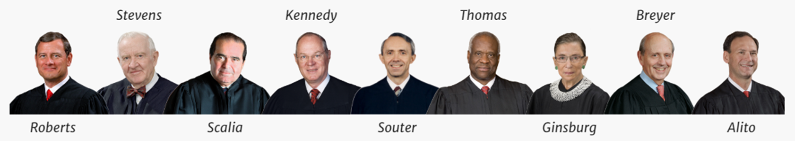
Purcell v. Gonzalez – Decision:
In a one-page, per curiam decision, the Court held that the Ninth Circuit erred when it enjoined the enforcement of Proposition 200. Because the Ninth Circuit acted without sufficient facts (no District Court findings of fact and law) and too close to the election, the Supreme Court could not decide the case, so it reversed the injunction and ordered that the case remanded for further proceedings.

Slide 9
What Ever Happened to Arizona’s Prop 200?
It took seven more years for the U.S. Supreme Court to finally rule on the case.
After the Supreme Court remanded the case to the Ninth Circuit, the Ninth Circuit remanded it to the U.S. District Court. In the fall of 2007, the District Court granted summary judgment for the State of Arizona.
Plaintiffs appealed (again) to the Ninth Circuit. Purcell v. Gonzalez II was heard in 2009. In October 2010 the Ninth Circuit held that the requirement to provide proof of citizenship to register to vote was preempted by Section 6 of the NVRA but that the requirement to provide a picture ID to vote at the polling place was permitted.
Arizona appealed to the U.S. Supreme Court (again). In the summer of 2013, the Court affirmed the Ninth Circuit 7–2, with Justice Antonin Scalia writing for the Court. Purcell v. Gonzalez II held that Arizona's proof of citizenship requirement for voter registration was preempted by the NVRA. A companion case, Inter Tribal Council v. Arizona was the lead case, also decided 7-2.

Slide 10
…Fun Note
Former U.S. Supreme Court Justice Sandra Day O’Connor sat on the 2009 Ninth Circuit panel for Purcell v. Gonzalez II as a retired Supreme Court justice. Purcell v. Gonzalez I was submitted to the Court nine months after she left the U.S. Supreme Court. Otherwise, she (likely) would have recused herself for the second case.

Slide 11
Purcell's Progeny

Slide 12
The 2020 Wisconsin Primary Election
COVID-19 adversely affected many 2020 elections, none more so than the Wisconsin Primary Election, scheduled for April 7, 2020. The election included the major parties’ presidential primary, a seat on the Wisconsin Supreme Court, three seats on the Wisconsin Court of Appeals, over 100 other judgeships, over 500 school board seats, and several thousand local offices.

Slide 13
Republican National Committee v. Democratic National Committee
On March 24, 2020, Governor Tony Evers ordered Wisconites to stay home until April 24 to slow the spread of COVID-19. The election was scheduled for April 7, 2020. On March 28, 2020, several plaintiffs brought suit to extend access to absentee ballots. After oral arguments on April 2, 2020, U.S. District Judge William Conley extended the deadline for absentee ballots in two ways:
He extended the deadline for voters to request an absentee ballot by one day from April 2 to April 3
He extended the deadline for election officials to receive voted ballots from election day to six days later, April 13.
Governor Evers issued an executive order moving the election from April 7 to June 9, 2020. However, Republican state legislators asked the Wisconsin Supreme Court to overturn the order, which they did by a 4-2 vote hours later.
That same day, Judge Conley’s ruling was appealed to the U.S. Supreme Court.

Slide 14
Republican National Committee v. Democratic National Committee - Decision
The U.S. Supreme Court received plaintiff’s appeal the next day, April 3, 2020, and issued a 5-4 opinion within 30 hours. The per curiam majority, citing the Purcell Principle, held that the District Court erred in making a dramatic change to election law days before election day. Majority holding - “…lower federal courts should ordinarily not alter the election rules on the eve of an election.”
Justice Ruth Bader Ginsburg dissented, joined by Justices Breyer, Sotomayor and Kagan. Ginsburg, also citing the Purcell Principle, concluded that it was the U.S. Supreme Court that was violating the Purcell Principle. She concluded “tens of thousands of voters who timely requested ballots are unlikely to receive them by April 7.” Thus, Wisconsin voters will have to choose between going to the polls, “endangering their own and others’ safety,” or “los[ing] their right to vote, through no fault of their own.”

Slide 15
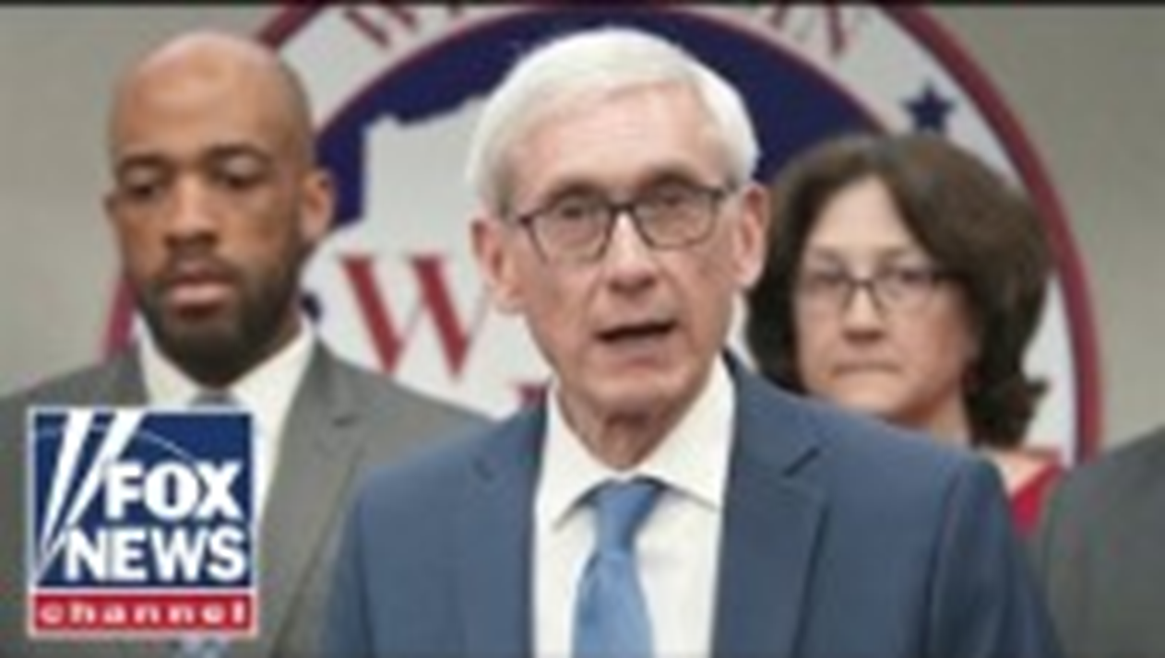
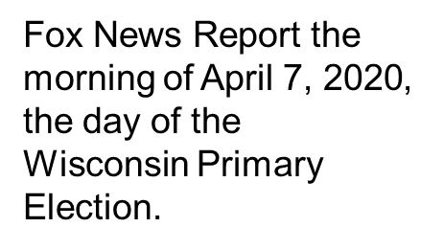
Wisconsin 2020 State Primary Election

Slide 16
Recent Examples of Purcell Principle in Action
Lake v. Hobbs
Kari Lake, the losing candidate for Arizona Governor, sued Katie Hobbs, the current Arizona Governor, claiming that Lake lost the election due to “untrustworthy” voting systems. U.S. District Court Judge John Tuchi dismissed the case on summary judgment, finding Lake’s claims “conjectural…and too speculative.”
Judge Tuchi further found that to entertain Lake’s effort to enjoin a winning candidate from taking office 18 months after an election would violate the Purcell Principle by asking the Court to intervene long after the actual election occurred.

Slide 17
Recent Examples of Purcell Principle in Action
Abdus-Sabur v. Evans
On August 29, 2023, a state court judge in Connecticut dismissed a lawsuit by a New Haven mayoral candidate. Shafiq Abdus-Sabur sued after the city clerk disqualified him for failing to acquire a sufficient number of valid petition signatures.
Judge Paul Doyle dismissed the suit under the Purcell Principle. He held that ballots for the September 12, 2023 primary were mailed August 22, 2023, but Abdus-Sabur’s suit was only filed on August 16, 2023. This left the court and election officials too little time to consider the claim.

Slide 18
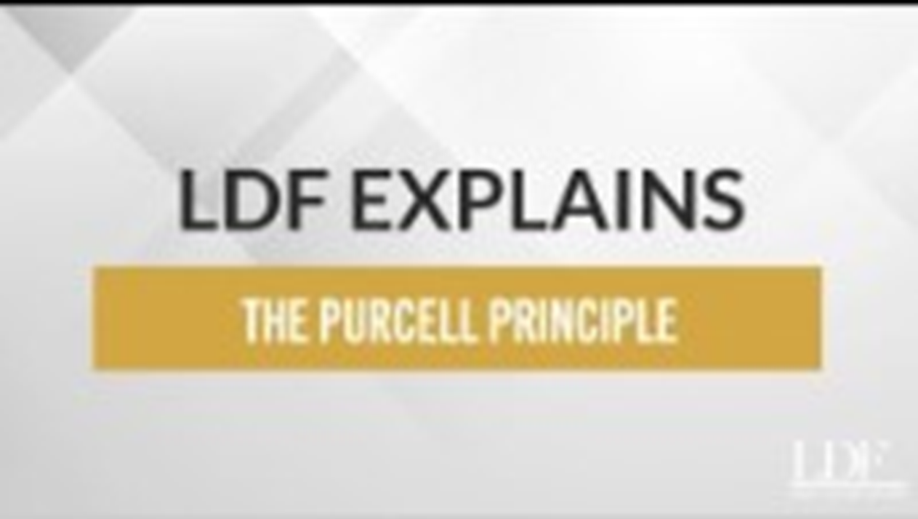
Criticism of Purcell Principle
The Legal Defense Fund (LDF) is a liberal group that advocates for racial and social policy change. The organization argues that Purcell has been used to stifle legitimate legal challenges.

Slide 19

Criticism of Purcell Principle (Cont)
In June 2023, the U.S. Supreme Court ruled that Alabama voters cast ballots in illegally drawn voting districts for Congress during the 2022 elections. In exactly the same case 14 months earlier, the Supreme Court refused to rule on a Gerrymandering claim citing the Purcell Principle. This meant that the Court’s failure to take the 2022 case essentially permitted illegal congressional districts to be used in Alabama’s 2022 congressional election.
To midterm voters in Alabama, Purcell’s application meant that their ballots were cast in congressional districts that a lower federal court ruled — and the U.S. Supreme Court later affirmed — violated the Voting Rights Act as a racial gerrymander that diluted the constitutional requirement to assure racial equity in congressional districts.
NPR did a story about the court’s ruling.

Slide 20
Purcell Principle in 2024

Slide 21
Purcell Principle 2024
Republican National Committee v. Mi Familia Vota (2024) – Unsigned order that reinstates an Arizona law requiring people registering to vote using the state voter registration form to demonstrate they are citizens. Both the U.S. District Court and the (a second) 9th Circuit Court of Appeals ruling found that the law violated the NVRA, Section 6 and the SCt’s holdings in Purcell II and Inter Tribal Council
Republican National Committee v. Wetzel (2024) – U.S. District Court granted summary judgment holding as unconstitutional Mississippi’s law requiring that election officials count ballots postmarked by election day but arriving to election officials after election day. The case was appealed to the 5th Circuit, where it was assigned to three judges on Sept 24.

Slide 22
Purcell Principle Takeaways
Purcell v. Gonzalez I started life as a minor dispute over a clearly unconstitutional provision in Arizona Proposition 200 requiring Arizonans to provide proof of citizenship when registering to vote. It morphed into one of the most important election law cases in recent memory due to some dicta in a one-page, shadow docket ruling.
Major Takeaways:
Purcell I stands for the principle that federal courts should not interpret election laws or policies in a way to change the administration of an election that might confuse voters or election administrators right before an election.
Since Purcell I these questions remain:
What qualifies as an election policy change that might be confusing to voters and election administrators?
How much deference a court should give the Purcell Principle and does that deference vary based on the merits and timing?
What qualifies as “close to an election” necessitating that courts rule to maintain a law or policy despite the merits of the case?
*You are an election official. If you in front of judge on an election law issue prior to an election – cite Purcell.

