Slide 1
Continuing Legal Education - Cybersecurity
Colorado Department of State

Slide 2
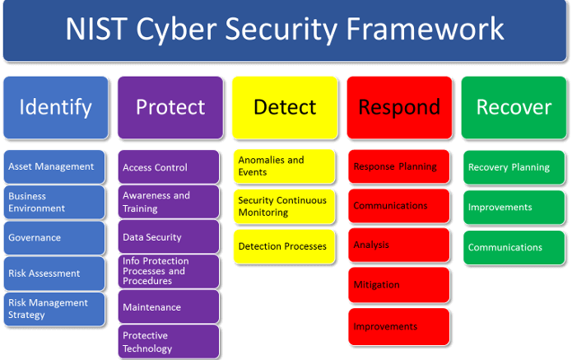
CLE – Cybersecurity in Practice
Measuring Risk
Cybersecurity Insurance
Malpractice Insurance
What are the most common threats and attacks in 2024
Legislation and cyber
What you can do for your business and clients to mitigate the impact of cyber attacks
I only have an hour today, so I won’t be able to go in-depth on some topics
This Photo by Unknown Author is licensed under CC BY-SA-NC

Slide 3

Cybersecurity Risk
Risk = (Threats x Vulnerabilities x Likelihood of Occurrence x Impact)/Mitigation
Do threat actors have a motive?
Is there low hanging fruit in your organization?
Is your organization a high value target?
Is your client a high value target?
If you lose client data what will the impact be?
If your systems are down how much will it cost per day? Can you even recover?

Slide 4

Key Takeaways
Inventory all the hardware and software that is allowed to run on your network.
Run a traditional antivirus that is up-to-date and completes a full scan of your systems weekly.
Ensure web and spam/email filtering is enabled in your AV protection.
Run End-Point Detection Software with advanced threat detection and automatic isolation.
Have a local host-based firewall on all systems
Automate the patching of your systems every week.
Use unique complex passwords that consist of a phrase, with two-factor authentication or biometrics for anything that you care about.

Slide 5
Key Takeaways (cont’d)
Ensure all systems are backed up daily, weekly, and monthly. Test your backups regularly.
Isolate backups from the network so if a ransomware attack occurs your backups are safe.
Review the Center for Internet Security Controls with your IT staff or a consultant.
Ensure sensitive data is encrypted when you store it and when you send it.
Use a VPN when connected to public Wi-Fi networks.

Slide 6
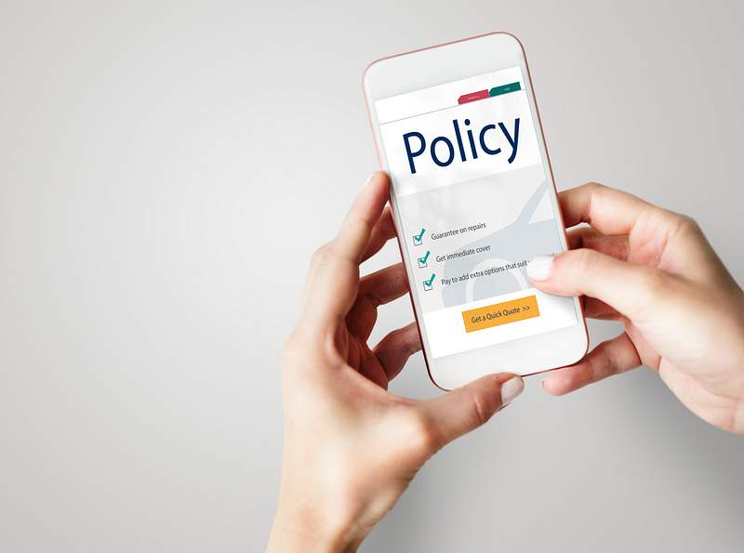
Insurance
Cybersecurity Insurance
Malpractice Insurance
Read your policy!
Realize it may slow down incident response and recovery.
If you claim you have protections in place that are not there you will be in for a fight.
It is always best to avoid a claim by stopping a cyber attack…insurance is not a leave it and forget it solution.
Cyber Insurance is evolving quickly.

Slide 7
Email Signatures & Other Notices
There is no easy button to remove liability
Email Confidentiality Disclaimers: Annoying But Are They Legally Binding? (cenkuslaw.com)
https://cenkuslaw.com/annoying-email-confidentiality-disclaimers/
1.) To communicate and protect the confidential nature of the email
2.) In the case of law firms, to communicate that the email may be privileged (subject to attorney-client privilege)
3.) To disclaim the formation of a contract
4.) To assert a copyright in the email contents
5.) To disclaim liability for viruses transmitted by the email
6.) To disclaim a negligent misstatement
7.) To disclaim employer liability for the views of the employee-sender

Slide 8
Threats
Does someone have the motive to be a threat to your organization?
Does your organization have money?
Do you have ‘targets of opportunity’ vulnerabilities?
Are your clients high value targets?
Are your partners high value targets?
Do your clients have money?
Do you have cyber insurance?
Is your country a target?

Slide 9
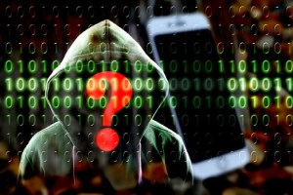
Attacks
You must understand the threats before you can understand how to defend yourself.
There are a lot of threats, but a group of mitigating controls stops them in their tracks!
This Photo by Unknown Author is licensed under CC BY
“If you know the enemy and know yourself, you need not fear the result of a hundred battles. If you know yourself but not the enemy, for every victory gained you will also suffer a defeat. If you know neither the enemy nor yourself, you will succumb in every battle.” Sun Tzu – The Art of War

Slide 10
Attacks
What have we seen in 2024?
Malware
Denial-of-Of Service (DoS)
Phishing
Spoofing
Identity-Based Attacks
Code injection Attacks
Supply Chain Attacks
Social Engineering Attacks
Insider Threats
DNS Tunneling
IoT-Based Attacks
AI-Powered Attacks
    https://www.crowdstrike.com/cybersecurity-101/cyberattacks/most-common-types-of-cyberattacks/

Slide 11
Malware
Some Common Types
Ransomware
Fileless Malware
Spyware
Trojan
Worm
Rootkits
Mobile Malware
Scareware
Keylogger
Wiper Attack
Malware describes malicious applications and code that damage or disrupt the normal use of endpoint devices. When a device becomes infected with malware, you may experience unauthorized access, compromised data, or being locked out of the device unless you pay a ransom.

Slide 12
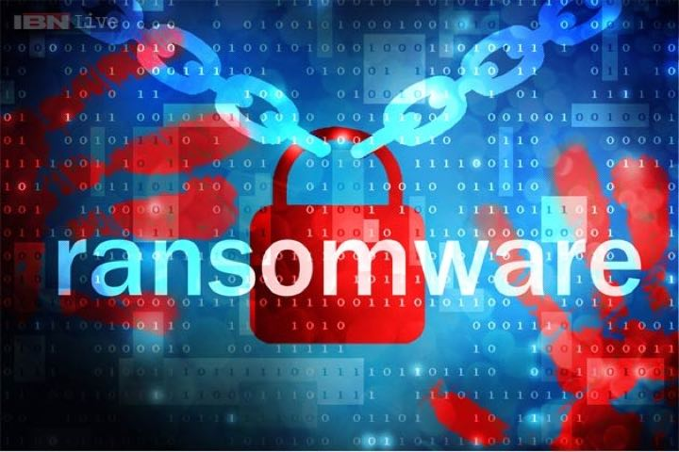
Malware - Ransomware
“In a ransomware attack, an adversary encrypts a victim’s data and offers to provide a decryption key in exchange for a payment. Ransomware attacks are usually launched through malicious links delivered via phishing emails, but unpatched vulnerabilities and policy misconfigurations are used as well.”
Usually involves data exfiltration.
What is the cost of protection versus the cost of a breach?
Many have lost their entire business. Governments and hospitals have been taken offline for weeks and months!
At some point we will no longer be allowed to pay the ransom!
This Photo by Unknown Author is licensed under CC BY-SA-NC

Slide 13
Malware - Fileless
Fileless malware is a type of malicious activity that uses native, legitimate tools built into a system to execute a cyber-attack. Unlike traditional malware, fileless malware does not require an attacker to install any code on a target’s system, making it hard to detect.
This is one of the reasons traditional antivirus solutions are not enough.
Endpoint Detection and Response (EDR), Extended Detection and Response (XDR), and Managed Detection and Response (MDR) are needed.

Slide 14
Malware - Spyware
Spyware is a type of unwanted, malicious software that infects a computer or other device and collects information about a user’s web activity without their knowledge or consent.
Spyware and tracking devices have become easy for anyone to utilize.

Slide 15
Malware - Trojan
A trojan is malware that appears to be legitimate software disguised as native operating system programs or harmless files like free downloads. Trojans are installed through social engineering techniques such as phishing or bait websites. The zeus trojan malware, a variant, has the goal accessing financial information and adding machines to a botnet.
It is important to only use and allow software from trusted companies.
Don’t ‘root’ your phone to use some cool new software.
Install an anti-malware tool like Sophos on your phone.
We will talk more about IoT and Botnets in DDoS attacks.

Slide 16
Malware - Worm
Malware – Wiper
A worm is a self-contained program that replicates itself and spreads its copies to other computers. A worm may infect its target through a software vulnerability, or it may be delivered via phishing or smishing. Embedded worms can modify and delete files, inject more malicious software, or replicate in place until the targeted system runs out of resources.
A wiper attack is designed to permanently delete or corrupt data on targeted systems. They are often observed in geopolitical conflicts and in a hacktivism context.

Slide 17
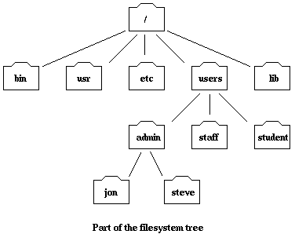
Malware - Rootkit
Rootkit malware is a collection of software designed to give malicious actors control of a computer network or application. Once activated, the malicious program sets up a backdoor exploit and may deliver additional malware. Rootkits take this a step further by infecting the master boot prior to the operating system booting up, making them harder to detect.
Only install software from trusted sources.
Harden systems with Center for Internet Security Standards (CIS)
Endpoint Detection and Response (EDR), Extended Detection and Response (XDR), and Managed Detection and Response (MDR) are needed.
This Photo by Unknown Author is licensed under CC BY-NC

Slide 18
Malware - Scareware
Scareware tricks users into believing their computer is infected with a virus. Typically, a user will see scareware as a pop-up warning them that their system is infected. This scare tactic aims to persuade people into installing fake antivirus software to remove the “virus.” Once this fake antivirus software is downloaded, then malware may infect your computer.
Way too common.
Takes advantage of people who do not know what to do.
They don’t even have to infect the computer….they convince people to give a ‘support agent’ remote access to the computer.
All they need to do is close their browser!

Slide 19
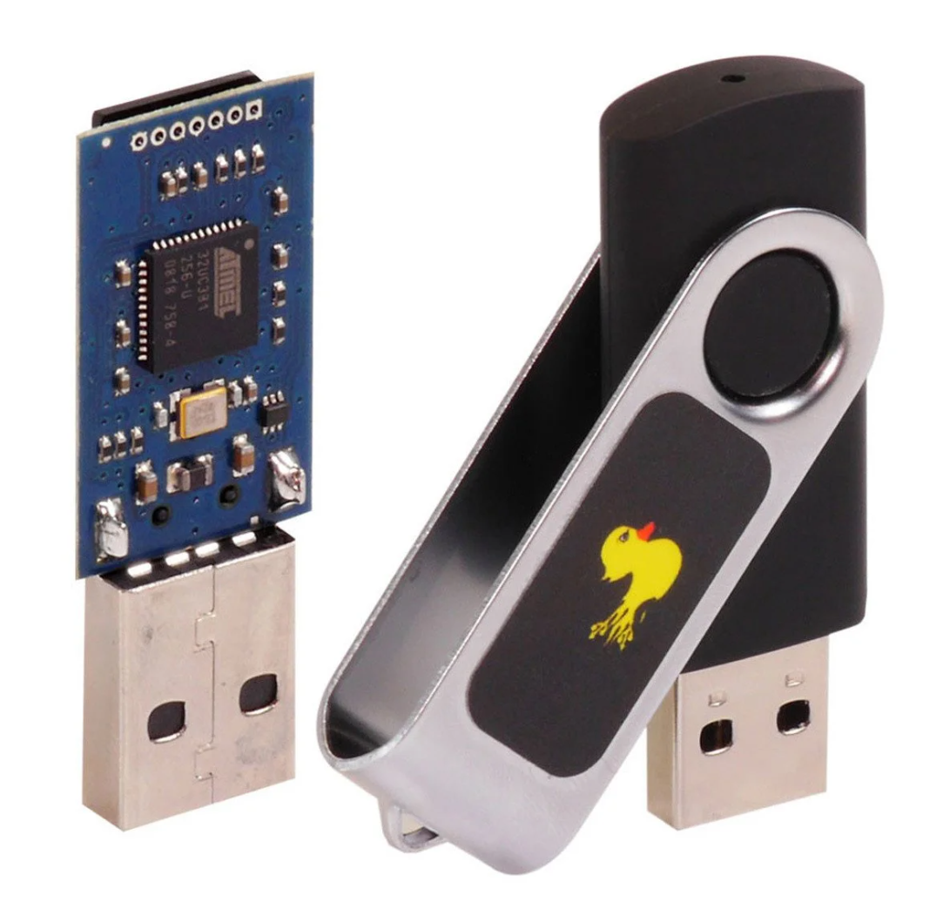
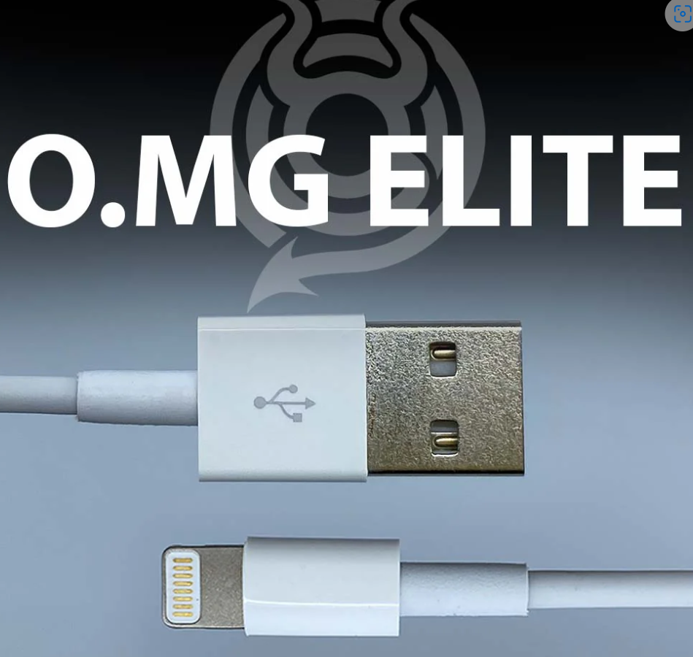
Malware - Keylogger
Keyloggers are tools that record what a person types on a device. While there are legitimate and legal uses for keyloggers, many uses are malicious. In a keylogger attack, the keylogger software records every keystroke on the victim’s device and sends it to the attacker.
Easy to get and use.
Divorce lawyers see this and GPS trackers a lot.
Software and hardware based.
Rubber Ducky and O.MG Elite Cable seen below.

Slide 20
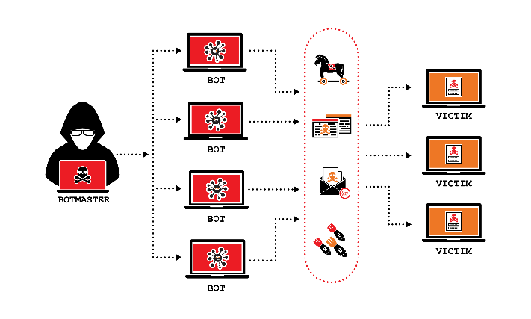
Denial of Service
Often caused by human error or by simply overwhelming a site.
Cloud outages, Internet outages, Website down.
Unfortunately, it is not expensive to perform a DDoS (Distributed Denial of Service Attack).
We all need to part of the solution to stop this problem!
A Denial-of-Service (DoS) attack is a malicious, targeted attack that floods a network with false requests in order to disrupt business operations.
This Photo by Unknown Author is licensed under CC BY-NC
“…on several crimeware sites and found that having a hacker create your own personal botnet would run you about $500” - https://www.secplicity.org/2017/03/07/know-much-costs-rent-iot-botnet/”

Slide 21
Phishing
“Phishing is a type of cyberattack that uses email, SMS, phone, social media, and social engineering techniques to entice a victim to share sensitive information — such as passwords or account numbers — or to download a malicious file that will install viruses on their computer or phone.”
“The median time for users to fall for phishing emails is less than 60 seconds” – Verizon Data Breach Investigation Report - https://verizon.com/dbir
This goes beyond links in emails, pay attention to attachments with malicious content. Block email attachments that have macros other active scripting content.

Slide 22
Spoofing
Spoofing is a technique through which a cybercriminal disguises themselves as a known or trusted source. In so doing, the adversary is able to engage with the target and access their systems or devices with the ultimate goal of stealing information, extorting money or installing malware or other harmful software on the device.
Domain Spoofing
  Many governments and business across the United States and Colorado have seen this type of attack.
  I.e. www.myc0untyg0verment.com
    Using substitution and misspellings is an easy way to trick users into going to the wrong domain.
Email Spoofing

Slide 23
Identity-Based Attacks
Identity-driven attacks are extremely hard to detect. When a valid user’s credentials have been compromised and an adversary is masquerading as that user, it is often very difficult to differentiate between the user’s typical behavior and that of the hacker using traditional security measures and tools.
Password attacks, Brute-Force, Other more complicated attacks

Slide 24
Code Injection
Code injection attacks consist of an attacker injecting malicious code into a vulnerable computer or network to change its course of action. There are multiple types of code injection attacks.
Websites and Web Applications
Databases

Slide 25
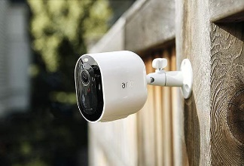
Supply Chain Attacks
We must be part of the solution!
The Federal Government sends out warning of “potential issues”. These are not really “potential issues”, they are real.
The fine line government walks to protect our infrastructure and businesses is important to note.
New Cyber Trust Label on the way!
  https://www.darkreading.com/ics-ot-security/fcc-approves-voluntary-cyber-trust-labels-iot-products
A supply chain attack is a type of cyberattack that targets a trusted third-party vendor who offers services or software vital to the supply chain. Software supply chain attacks inject malicious code into an application in order to infect all users of an app, while hardware supply chain attacks compromise physical components for the same purpose. Software supply chains are particularly vulnerable because modern software is not written from scratch: rather, it involves many off-the-shelf components, such as third-party APIs, open source code and proprietary code from software vendors.
This Photo by Unknown Author is licensed under CC BY-SA-NC

Slide 26
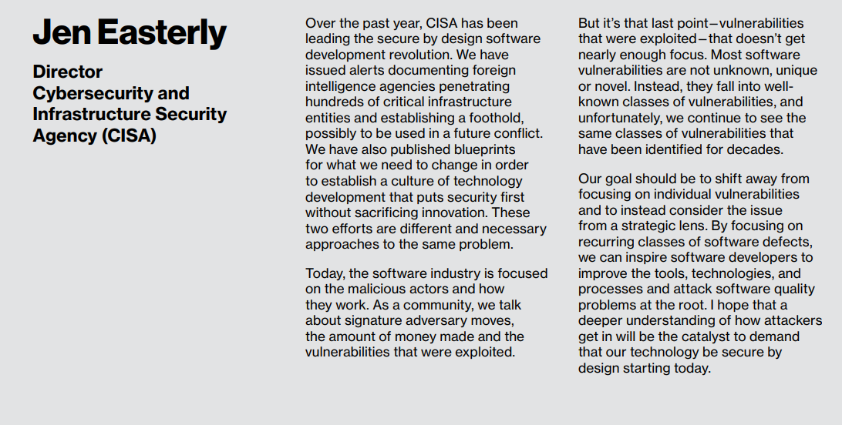
Secure by Design

Slide 27
Social engineering attacks
Social engineering is a technique where attackers use psychological tactics to manipulate people into taking a desired action. Through the use of powerful motivators like love, money, fear, and status, attackers can gather sensitive information that they can later use to either extort the organization or leverage such information for a competitive advantage.
Pretexting
Business Email Compromise (BEC)
Disinformation Campaign
Quid Pro Quo
Honeytrap
Tailgaiting

Slide 28
Business Email Compromise - BEC
Examples
A vendor your company regularly deals with sends an invoice with an updated mailing address.
A company CEO asks her assistant to purchase dozens of gift cards to send out as employee rewards. She asks for the serial numbers so she can email them out right away.
A homebuyer receives a message from his title company with instructions on how to wire his down payment.
In a BEC scam, criminals send an email message that appears to come from a known source making a legitimate request.

Slide 29
Insider Threats
IT teams that solely focus on finding adversaries external to the organization only see half the picture. Insider threats are internal actors such as current or former employees that pose danger to an organization because they have direct access to the company network, sensitive data, and IP as well as knowledge of business processes, company policies, or other information that would help carry out such an attack.
This is one of the toughest to combat for sure!
Background checks
Honey Pots/Artifacts
Logging and Monitoring
Principle of Least Privilege
Privilege Access Management
Acceptable Use Policies
Non-disclosure agreements

Slide 30
DNS Tunneling
DNS Tunneling is a type of cyberattack that leverages domain name system (DNS) queries and responses to bypass traditional security measures and transmit data and code within the network.
Not common unless you are a high value target.

Slide 31
IoT Based Attacks
An internet of things (IoT) attack is any cyberattack that targets an IoT device or network. Once compromised, the hacker can assume control of the device, steal data, or join a group of infected devices to create a botnet to launch DoS or DDoS attacks.
Again, we have to be part of the solution.
You get what you pay for!
New Cyber Trust Label on the way!
  https://www.darkreading.com/ics-ot-security/fcc-approves-voluntary-cyber-trust-labels-iot-products
This is only the first step.

Slide 32
Future Threats
Artificial Intelligence
  Voice verification
  Captchas
  Deep Fakes
  AI Malware and other attacks
Quantum Computing
  Store now, decrypt later
  New standards – entire infrastructure including hardware will need to be upgraded
  12 years out?
What is coming in the ‘near’ future?

Slide 33
CIS Controls
The Center for Internet Security has some of the best templates for building a strong cybersecurity program.
This would be great to review with your IT team?
  https://www.cisecurity.org/controls
  https://www.cisecurity.org/controls/cis-controls-navigator

Slide 34
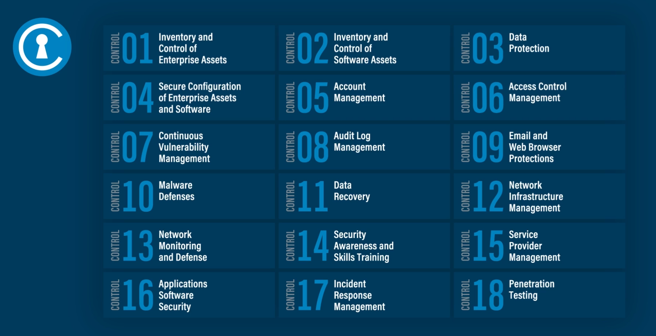
CIS Controls (cont’d)
These are ranked from the most important to the least.
We will quickly go over the fundamentals of the top controls.
https://www.cisecurity.org/controls/cis-controls-list

Slide 35
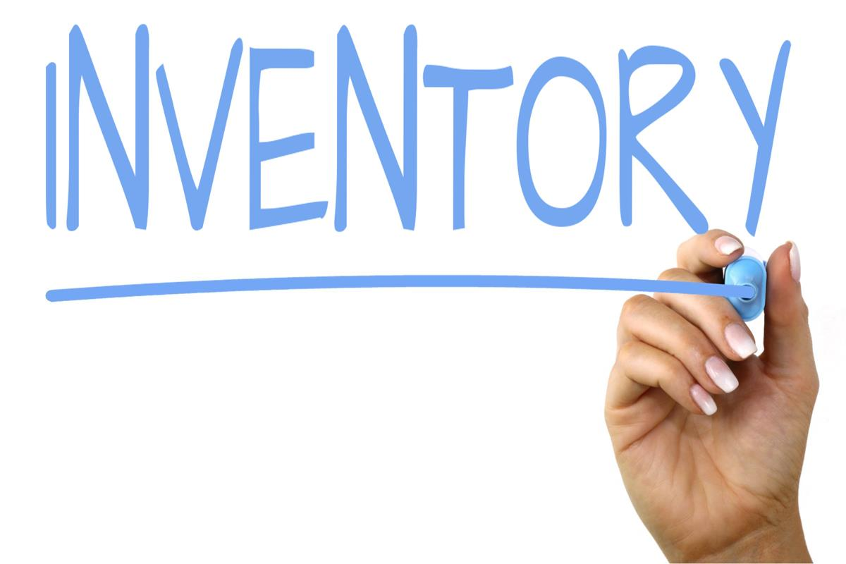
Inventory – What hardware do you allow?
Keep it simple…if a device should not be on your network make sure it isn’t!
Know what laptops, servers, and cloud services you are using.
Depending on your organization size, this could be a simple spreadsheet.
Require that all devices have patching enabled automatically, Anti-virus updated automatically and are running an Endpoint Detection and Response Tool.
Larger organizations should require an agent to check for hardening and patching. (All organization if possible)
This Photo by Unknown Author is licensed under CC BY-SA
This Photo by Unknown Author is licensed under CC BY-SA

Slide 36

Inventory – What software do you allow?
Keep it simple…Don’t allow staff to download or install software without approval. Only approve software from reputable sources.
Have an approved software list.
Only run approved software.
Don’t allow anyone, yes this applies to everyone, to run their system as an administrator when performing their daily work.
This Photo by Unknown Author is licensed under CC BY-SA

Slide 37
Data Protection
Again, keep a list of the data you have, where it is kept, and if it has sensitive information. With that establish a data governance policy.
Data Governance
  How long do you need to retain the data?
  How often do you need to backup the data?
  Do you need to keep different point-in-time data backups: Daily, Weekly, Monthly, Annually?
  How often will you test restoring the data?
  Should the data be sent encrypted?
  Should the data be encrypted when it is stored?
This Photo by Unknown Author is licensed under CC BY-SA

Slide 38
Secure Configurations
Secure Configuration
  CIS hardening standards for devices
  Endpoint Detection and Response (EDR) required on all devices
  EDR 24x7 monitoring if possible
  Configure automatic scheduled patching
  Ensure all endpoints have a local firewall turned on
Work with an Information Systems consultant, company, or staff to ensure your systems are hardened and configured securely.

Slide 39
Account Management
Account Controls
  Have complex passwords that are at a minimum 15 characters, but preferably substantially longer. This is not hard….use phrases of dissimilar words with numbers, symbols, and mixed case. (Yes, I know this varies)
  Implement multi-factor authentication on anything and everything.
  Implement biometrics when possible.
  Turn on account lockouts for incorrect password attempts over 8. Set the lockout for at least 15 minutes if not longer. This is critical!
  Never use the same password for different groups of systems.
  Monitor accounts for incorrect password attempts.
  Don’t go to SMS for codes when using two-factor authentication (2FA); it’s not the safest option.
Ensure accounts on all systems including cloud services like M365, have good security in place.

Slide 40
Password Guidelines
Elimination of Periodic Password Changes
Previous Requirement: Users were often required to change their passwords periodically (e.g., every 90 days).2024 Update: NIST now recommends against periodic password changes unless there is evidence of a compromise. Frequent changes can lead to weaker passwords as users may create simple, predictable patterns. Longer Passwords Over Complexity. (Unless specific legal or compliance obligations, such as PCI compliance, are in place)
Previous Requirement: Emphasis was on password complexity (mix of uppercase, lowercase, numbers, and special characters).2024 Update: NIST emphasizes allowing longer passwords (up to 64 characters) over complex ones. Users can create passphrases that are easier to remember and harder to crack. Screening Against Common Password Lists
Previous Requirement: Passwords were checked primarily for length and character requirements.2024 Update: Organizations should screen new passwords against lists of commonly used, expected, or compromised passwords. This reduces the likelihood of users choosing easily guessable passwords. Encouraging Password Managers
Previous Requirement: Limited guidance on the use of password managers.2024 Update: NIST recommends the use of password managers to create and store strong, unique passwords for each account. This practice enhances security by reducing password reuse and simplifying password management for users. Multi-Factor Authentication (MFA)
Previous Requirement: MFA was recommended but not emphasized for all accounts.2024 Update: Strong emphasis on the use of MFA for an added layer of security, particularly for sensitive accounts and systems. MFA significantly reduces the risk of unauthorized access, even if a password is compromised. No Composition Rules
Previous Requirement: Strict composition rules (e.g., must include special characters, numbers, and mixed cases) were often enforced.2024 Update: NIST advises against mandatory composition rules. Instead, it recommends allowing users to create passphrases and only enforcing rules that prevent common or easily guessable passwords. Password Hint and Knowledge-Based Authentication
Previous Requirement: Password hints and knowledge-based authentication (e.g., security questions) were common.2024 Update: NIST advises against the use of password hints and security questions as they often provide weak security and can be easily guessed or researched. Rate Limiting and Lockouts
Previous Requirement: Account lockouts after several failed login attempts were commonly implemented.2024 Update: NIST recommends rate limiting (delaying responses after failed attempts) rather than lockouts. This approach helps mitigate brute force attacks while reducing the risk of denial-of-service conditions where users are locked out of their accounts.
Good reference article for 2024 Guidelines:
https://community.trustcloud.ai/article/nist-password-guidelines-2024-15-rules-to-follow/
Bottom line: Use a long pass phrase that nobody knows, don’t use the same pass phrase on all systems, and whenever available use two-factor authentication or biometrics. Oh….and text messages/SMS is not great for your 2nd factor!

Slide 41
EDR – Endpoint Detection and Response
EDR is a cybersecurity technology that continuously monitors endpoints for evidence of threats and performs automatic actions to help mitigate them.
Questions:
Will the solution run on all your endpoints? (Max, Windows, Linux)
Does the solution provide remediation and blocking of threats on all platforms, not just detection?
Does the solution have an option for 24x7 monitoring?
Does the solution provide tools for advanced threat hunting if needed?
There are lots of EDR vendors. Some examples:
  Palo Alto Networks Cortex XDR
  Sentinel One
  CrowdStrike Falcon Insight
  Microsoft Defender XDR
  Trend Micro Vision One
  Cybereason Defense Platform

Slide 42
Sensitive Data Protection
Encryption at rest and in transit
Data retention policy and governance
Encrypt emails using a service if sensitive information is transmitted.
Ensure sensitive information is encrypted when stored.
Only keep data for as long as you have to for compliance and business needs!

Slide 43
SaaS/Cloud
If you are a small to medium size organization, leverage the cloud. Don’t try and run a datacenter or a server in a closet somewhere.
All the major cloud vendors have great tools for data management and ease of use.

Slide 44
BEC Tips
Business Email Compromise has been a huge issue in Colorado this year. Be alert, don’t hurry, verify, and establish protocols with your teams ahead of time!
Be careful with what information you share online or on social media. By openly sharing things like pet names, schools you attended, links to family members, and your birthday, you can give a scammer all the information they need to guess your password or answer your security questions.
Don’t click on anything in an unsolicited email or text message asking you to update or verify account information. Look up the company’s phone number on your own (don’t use the one a potential scammer is providing), and call the company to ask if the request is legitimate.
Carefully examine the email address, URL, and spelling used in any correspondence. Scammers use slight differences to trick your eye and gain your trust.
  https://www.virustotal.com – Great tool to check files and links for potential malware.
Be careful what you download. Never open an email attachment from someone you don't know and be wary of email attachments forwarded to you.
Set up two-factor (or multi-factor) authentication on any account that allows it, and never disable it.
Verify payment and purchase requests in person if possible or by calling the person to make sure it is legitimate. You should verify any change in account number or payment procedures with the person making the request.
Be especially wary if the requestor is pressing you to act quickly.
Teams, Zoom, Webex calls. (Establish a protocol that AI would not understand)

Slide 45
Final Items
Use a VPN service when ever connected to public or hotel Wi-Fi.
Backup important data to more than one service and make sure you test restoring the data periodically.
Chose and anti-virus solution that also has web filtering and turn it on.
Don’t browse the general Internet on a computer that accesses sensitive information.
Ensure your email systems have spam filtering and malicious file detection capabilities.
Considering building a simple cybersecurity incident and communications plan.
Yes, there is always more, but this is a substantial start to protect your organization and your clients.

Slide 46
Key Takeaways - Recap
Inventory all the hardware and software that is allowed to run on your network.
Run a traditional antivirus that is up-to-date and completes a full scan of your systems weekly.
Ensure web and spam/email filtering is enabled in your AV protection.
Run End-Point Detection Software with advanced threat detection and automatic isolation.
Have a local host-based firewall on all systems
Automate the patching of your systems every week.
Use unique complex passwords that consist of a phrase, with two-factor authentication or biometrics for anything that you care about.

Slide 47
Key Takeaways – Recap (cont’d)
Ensure all systems are backed up daily, weekly, and monthly. Test your backups regularly.
Isolate backups from the network so if a ransomware attack occurs your backups are safe.
Review the Center for Internet Security Controls with your IT staff or a consultant.
Ensure sensitive data is encrypted when you store it and when you send it.
Use a VPN when connected to public Wi-Fi networks.

Slide 48
References
Business Email Compromise (BEC) – FBI.gov
  https://www.fbi.gov/how-we-can-help-you/scams-and-safety/common-scams-and-crimes/business-email-compromise
CrowdStrike – Most Common Attacks of 2024
  https://www.crowdstrike.com/cybersecurity-101/cyberattacks/most-common-types-of-cyberattacks/
Do you know how much it costs to rent a BotNet?
  https://www.secplicity.org/2017/03/07/know-much-costs-rent-iot-botnet/
Email Confidentiality Disclaimers: Annoying But Are They Legally Binding?
  https://cenkuslaw.com/annoying-email-confidentiality-disclaimers/
PII Laws and Standards
  https://www.csoonline.com/article/571817/what-is-pii-examples-laws-and-standards.html
Security and Privacy laws, regulations, and compliance: The complete guide: CSO Online
  https://www.csoonline.com/article/570281/csos-ultimate-guide-to-security-and-privacy-laws-regulations-and-compliance.html
Verizon 2024 Data Breach Investigations Report
  https://verizon.com/dbir

Slide 49
Continuing Education
What’s next?
https://www.coloradosos.gov/pubs/info_center/CLEseminars.html
Top 10 Violations of the Revised Uniform Law on Notarial Acts - September 12, 2024
Public Data Fundamentals for Lawyers - October 8, 2024
Contact Information
Rich.Schliep@ColoradoSOS.gov
Course ID: 838828

