Slide 1
Colorado Department of State Hilary Rudy, Deputy State Election Director
BEAC 2025 Coordinated Election
December 19, 2025

Slide 2
2025 Voter registration numbers
Colorado Department of State

Slide 3
Automatic voter registration
Colorado Department of State

Slide 4
Automatic voter registration 2025 new registrations

Slide 5
Automatic voter registration 2025 updated registrations

Slide 6
Automatic voter registration 2025 new pre-registrations (16-17 years old)

Slide 7
Online voter registration
Colorado Department of State

Slide 8
New online voter registrations 2025 by month

Slide 9
Updated online voter registrations 2025 by month

Slide 10
Voter registration numbers over time
Colorado Department of State

Slide 11
Registered voters 2015-2025
Note: As of December 1st each year

Slide 12
Voter registration by party 2015-2025

Slide 13
2025 Coordinated Election
Colorado Department of State

Slide 14
2025 Coordinated Election Active voter count
Voter Status | ACN | APV | CTR | DEM | FWD | GRN | LBR | NOL | REP | UAF | UNI | Grand Total
Active | 11,849 | 5,174 | 3,955 | 1,033,002 | 417 | 8,667 | 37,036 | 29,989 | 935,954 | 2,066,477 | 3,185 | 4,135,705
Inactive | 1,712 | 618 | 239 | 69,214 | 8 | 1,202 | 5,317 | 1,354 | 62,676 | 197,662 | 551 | 340,553
Grand Total | 13,561 | 5,792 | 4,194 | 1,102,216 | 425 | 9,869 | 42,353 | 31,343 | 998,630 | 2,264,139 | 3,736 | 4,476,258

Slide 15
2025 Coordinated Election Turnout numbers
All Accepted Ballot - Mail and In-person combined
Active Voters | ACN | APV | CTR | DEM | FWD | GRN | LBR | NOL | REP | UAF | UNI | Grand Total
4,135,705 | 2,114 | 550 | 815 | 518,655 | 208 | 2,554 | 10,264 | 4,876 | 441,533 | 734,632 | 454 | 1,716,655

Slide 16
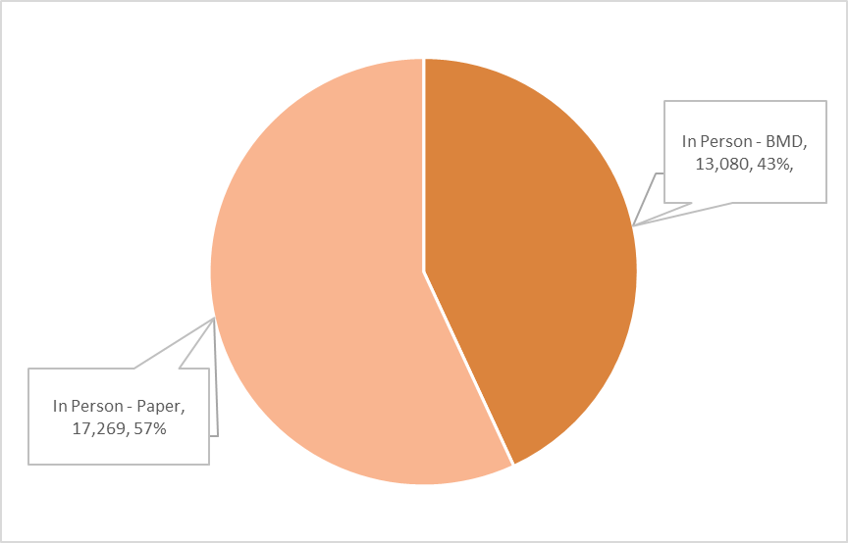
2025 Coordinated Election Voter service and polling centers
What transactions can occur at a VSPC?
Vote in person – void mail ballot, issue a new ballot
Paper ballot
Ballot Marking Device
Register to vote
Update voter registration
Number of Transactions – 30,349

Slide 17
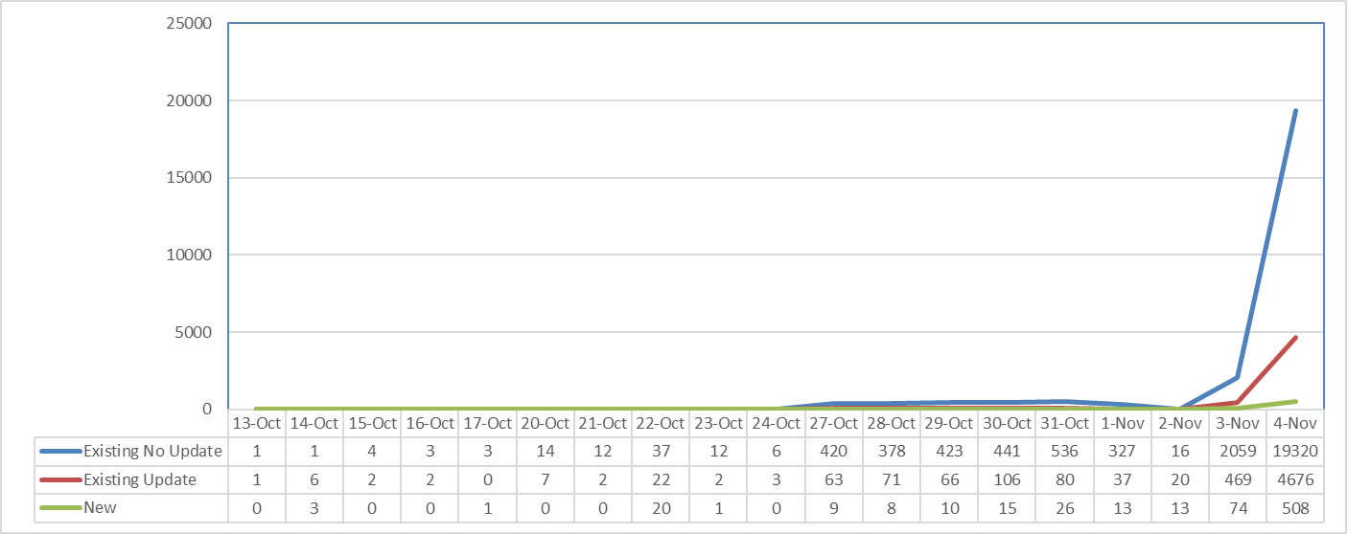
2025 Coordinated Election VSPC activity by day (30,349)

Slide 18
2025 Coordinated Election Turnout In-person voting
In Person Ballots
Total Votes Cast |  | In-Person Voting
Active Voters | Voted | Voted In-Person | % of Total
4,135,705 | 1,716,655 | 30,348 | 1.80%

Slide 19
2025 Coordinated Election Provisional ballots
34 provisional ballots were cast in the 2025 Coordinated Election
25 accepted
9 rejected

Slide 20
2025 Coordinated Election Canvass board data
59 Counties unanimously approved the 2025 Coordinated Election canvass report
Five counties did not receive the unanimous sign-off of the canvass report. Those counties were:
Arapahoe
Boulder
El Paso
Jefferson
Routt
In each case, the Republican representative the canvass board withheld their approval

Slide 21
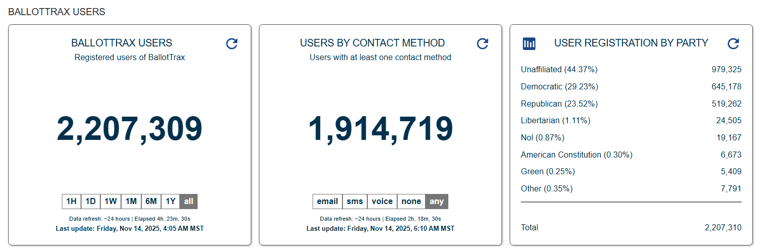
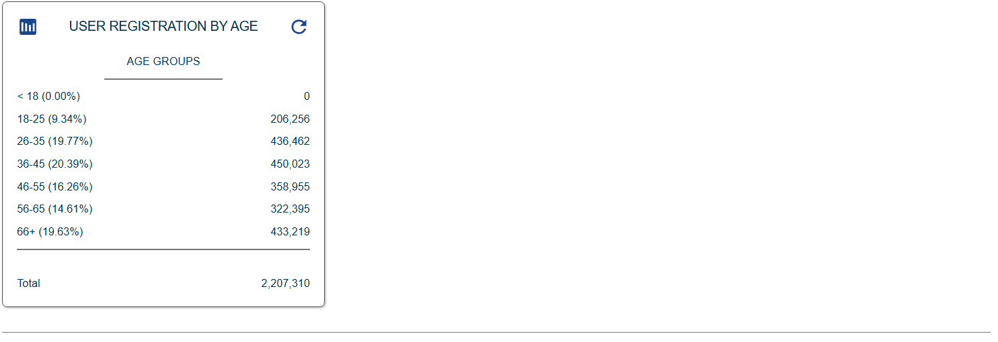
2025 Coordinated Election BallotTrax numbers
*53.5% of the state’s registered voters are BallotTrax users.
**Douglas County has the highest rate of BallotTrax users at 65.9%. Pitkin County is second at 63.4%.
***Sedgwick county has the lowest BallotTrax use at 28.0% followed by Phillips at 31%.

Slide 22
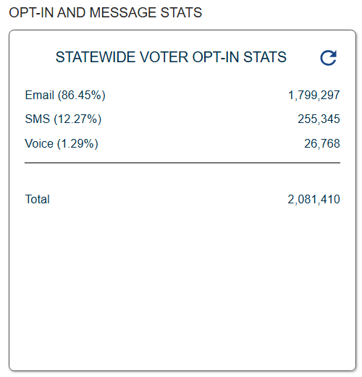
2025 Coordinated Election BallotTrax numbers continued…

Slide 23
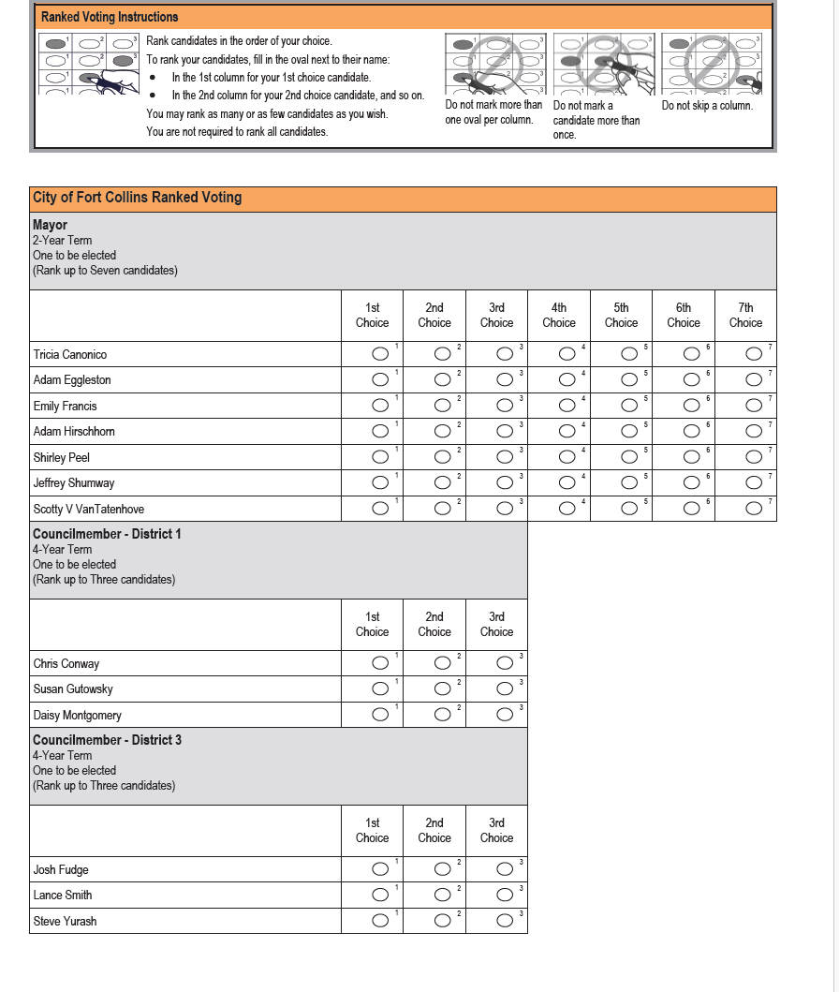
IRV (single-winner ranked voting)

Slide 24
What is an invalid vote, and why aren’t all mistakes?
An invalid vote is a marking pattern by a voter that causes some or all of the voter’s selections to be not counted. There are three types of invalid votes for an IRV contest: Overvote, Duplicate Ranking, Skipped Ranking.
A voter may purposefully mark a ballot in such a way that creates an invalid vote to otherwise express their opinion. For example, a voter may rank the same candidate for all ranks (duplicate ranking). But we can infer that the voter did that because they really like that candidate. Or they may rank one candidate one, and another candidate last, with no other candidates (skipped ranking). We can infer that voter like one candidate and really didn’t like the other candidate they ranked last.

Slide 25
Analysis
Contest | Total Ballots | Invalid Votes | Actual Voter Mistakes | Potential Voter Mistakes
2023 Boulder Mayor | 34,149 | 491 | 19 | 41
2025 Ft. Collins Council Races | 20,181 (9,821+10,360) | 121 | 21 | 10
2025 Ft. Collins Mayor | 57,101 | 2,233 | In progress | In progress

Slide 26
What does this say?
It’s safe to say that voters generally understood how to properly vote an IRV contest. In all three races voters had a very low number of invalid votes. When we drilled down, we found that the overwhelming number of invalid votes ended up not being mistakes but were otherwise expressing some opinion.
In both cases—Boulder and Larimer County—the county clerk’s office and city clerk’s office, as well outside groups, did extensive education campaigns to familiarize voters with the new voting method.
However, we did find based on initial analysis that the race with the larger grid (Ft. Collins Mayor, 7x7) resulted in more actual voter mistakes relative to turnout.

Slide 27
What’s next and limitations
The next potential IRV race that we’re aware of is the 2026 City of Boulder Mayor race (if there are more than 2 candidates). We’ll continue to gather data to see how voters adapt to the ranked voting method.
Our analysis is quantitative. We see potentially great value in doing a qualitative analysis of an IRV election.
How did voters feel about ranked voting?
Did voters get intimidated when facing the new method?
After voting and seeing results, did voters feel like ranked voting added value to their voting experience?
Since these are local races, we feel that our office is not the correct entity to undertake data gathering needed for a qualitative analysis.

