Slide 1
Colorado Department of State
Judd Choate, State Election Director
BEAC 2024 State Primary Election
September 6, 2024
303-869-4927
judd.choate@coloradosos.gov

Slide 2
Voter Registration
Colorado Department of State

Slide 3
Who is Eligible to Register to Vote in Colorado (and most of the U.S.)?
Legal Requirements:
Must be a U.S. Citizen
Must be 16 years of age (18 to vote)
Must be a Colorado resident
Can’t be a currently incarcerated Felon
What is residency? Legal term for where a person calls ”home.”

Slide 4
Automatic Voter Registration
Colorado Department of State

Slide 5
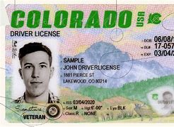
Automatic Voter Registration
Three Possibilities:
Voter Registration for an Eligible Citizen
The person is ineligible
  Not a Citizen
  Not 16 years of age yet
Currently Registered Voter
(If Data Moves Forward…)
Two Outcomes:
The elector’s county clerk verifies that the record is complete. If not, the registration is made incomplete and the voter is sent a mailing requesting the missing information.
If the elector’s record is complete, the county clerk approves the registration and sends a notice to the elector that they are registered to vote.
  The elector can return the notice to either decline to be registered or to affiliate with a party.
  If the elector does not decline to be registered within 20 days after the notice is mailed and the form is not returned as undeliverable, the elector is then registered to vote.

Slide 6
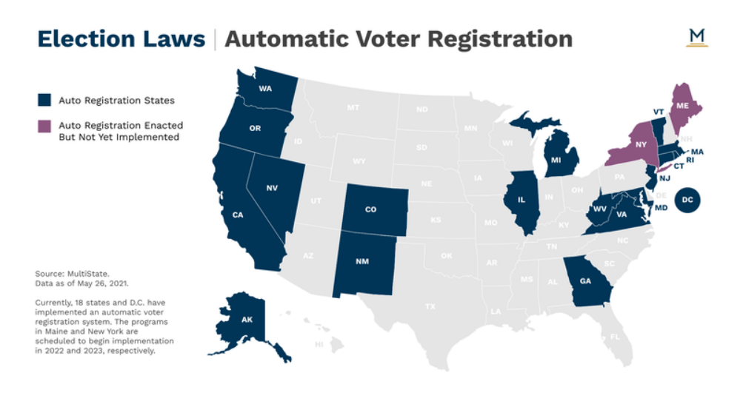
Automatic Voter Registration States

Slide 7
2024 Automatic Voter Registration
New Registrations

Slide 8
2024 Automatic Voter Registration
Updated Registrations

Slide 9
2024 Automatic Voter Registration
New Registrations (16-17 years old)

Slide 10
Online Voter Registration
Colorado Department of State

Slide 11
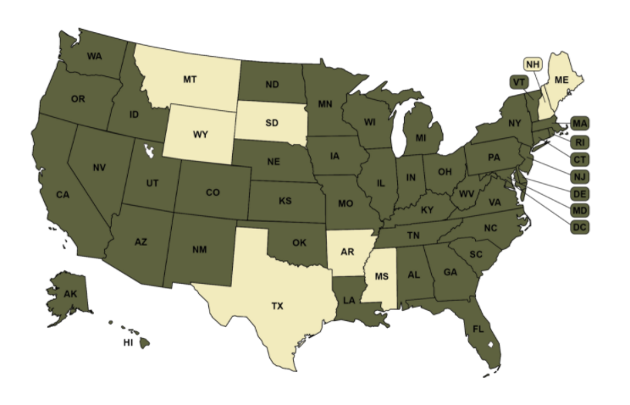
Online Voter Registration
42 states and the District of Columbia have online voter registration. A driver’s license is the basis for every online transaction – except NJ and CO.
The Department of State hosts an online voter registration site at www.govotecolorado.gov. This allows currently registered voters and eligible Coloradans to register to vote online, see a sample ballot, and verify their voter registration.
These applications are typically “complete” upon submission. So, the county approves the entry and sends a 20-day mailing to confirm the address - unless it’s an SSN application without a signature.

Slide 12
2020 New Online Voter Registrations by Month

Slide 13
2024 New Online Voter Registrations by Month

Slide 14
2020 Updated Online Voter Registrations by Month

Slide 15
2024 Updated Online Voter Registrations by Month

Slide 16
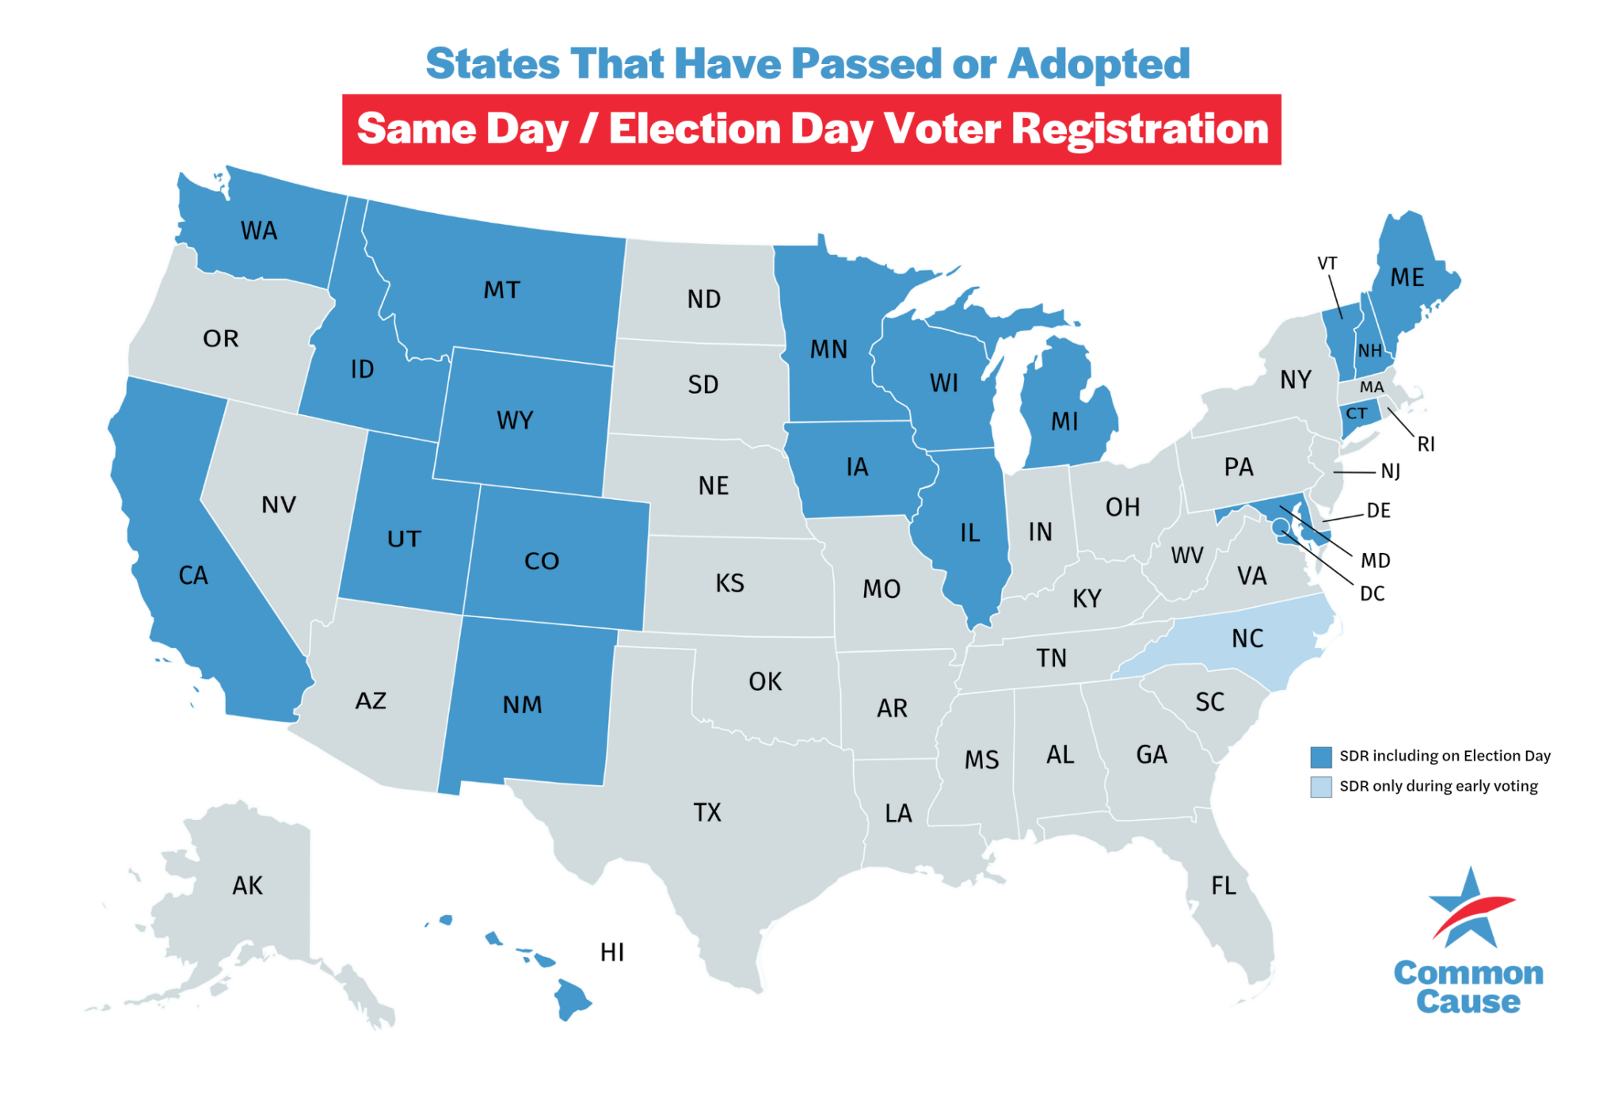
Same Day Registration States

Slide 17
Current Voter Registration Numbers
Colorado Department of State

Slide 18
Registered Voters 2014-2024
Note: As of December 1st each year

Slide 19
Colorado Voter Registration By Party
2014-2024

Slide 20
2024 State Primary Election
Colorado Department of State

Slide 21
2024 State Primary Election
Active Voter Count

Slide 22
2024 State Primary Election
Turnout Numbers

Slide 23
2024 State Primary Election
CD4 Active Voter Count

Slide 24
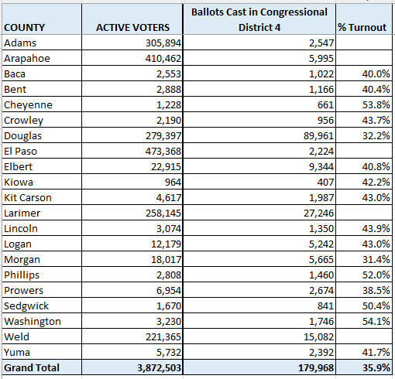
2024 State Primary Election
CD4 Turnout Numbers

Slide 25
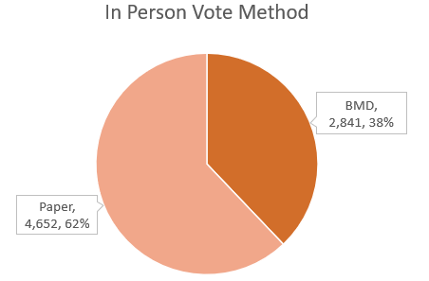
2024 State Primary Election
Voter Service and Polling Centers
What transactions can occur at a VSPC?:
Vote in person – void mail ballot, issue a new ballot
  Paper ballot
  Ballot Marking Device
Register to vote
Update voter registration
Number of Transactions – 7,493

Slide 26
2024 State Primary Election
VSPC Activity by Day (7,493)

Slide 27
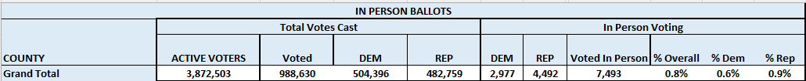
2024 State Primary Election Turnout
In-Person Voting

Slide 28
2024 State Primary Election Unaffiliated Voter Ballot Choice

Slide 29
2024 State Primary Election
Provisional Ballots
11 Provisional Ballots were cast in the 2024 State Primary Election
  3 accepted
  8 rejected

Slide 30
2024 State Primary Election
Canvass Board Data
61* Counties unanimously approved the 2024 State Primary canvass report.
Three counties did not receive the unanimous sign-off of the canvass report. Those counties were:
  Boulder
  El Paso
  Jefferson
In each case, the Republican representative the canvass board withheld their approval.
*Saguache County changed from a 2-1 vote to a 3-0 vote because the Republican Party Chair did not attend the Canvass. The next day a new Republican representative was appointed, who did approve.

Slide 31
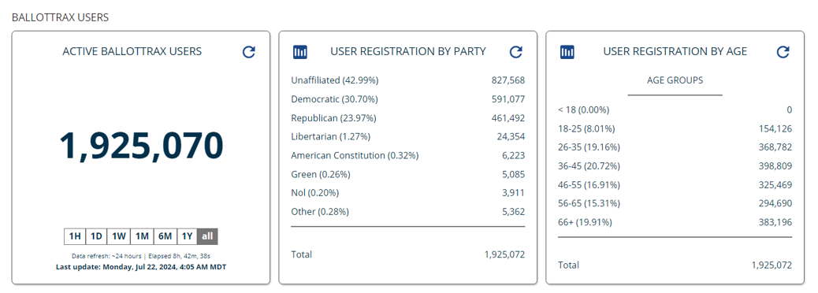
2024 State Primary Election
BallotTrax Numbers
*50.6% of the state’s registered voters are BallotTrax users.
**Douglas County has the highest rate of BallotTrax users at 64.6%. Pitkin County is second at 61.2%.
***Sedgwick county has the lowest BallotTrax use at 25.0% followed by Bent at 25.8%.
.

Slide 32
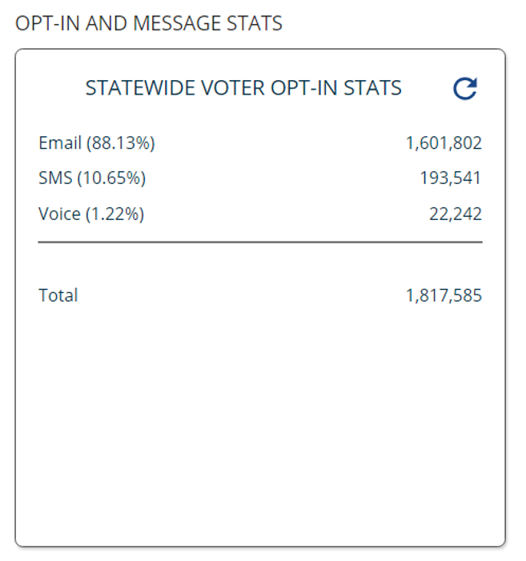
2024 State Primary Election
BallotTrax Numbers Continued…

Slide 33
Colorado In Relation to Other States
Colorado Department of State

Slide 34
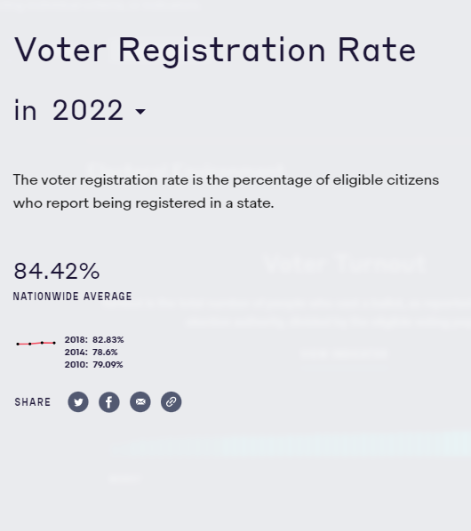
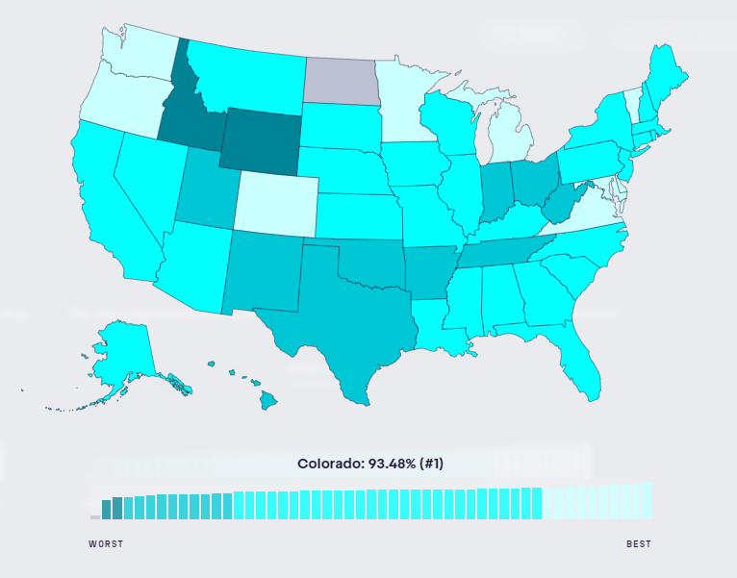
Colorado’s Voter Registration Rate
Compared to the Nation

Slide 35
Colorado v. National VEP Turnout
2000-2022

Slide 36
Top States VEP Turnout
2000-2022

Slide 37
Thank you.
Colorado Department of State
Judd Choate, State Election Director
judd.choate@coloradosos.gov
303-869-4927

